Slide 1
ECEN 350 Electronic Devices and Circuits
Metal Oxide Field Effect Transistors

Slide 2
ECEN 350 – Topics
Semiconductor Physics
IC Op-Amps
Rectifiers
Zeners
Diodes
BJTs
MOSFETs
CMOS
LEDs
Transistor Biasing
Small-Signal Analysis
Amplifier Gain Stages
Frequency Response

Slide 3
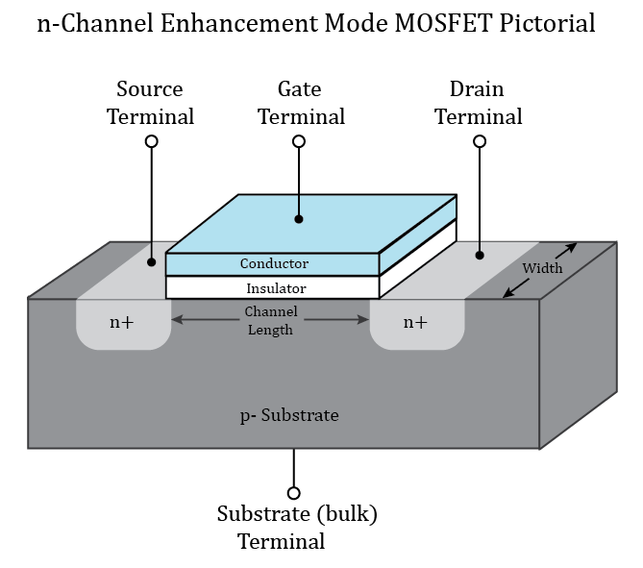
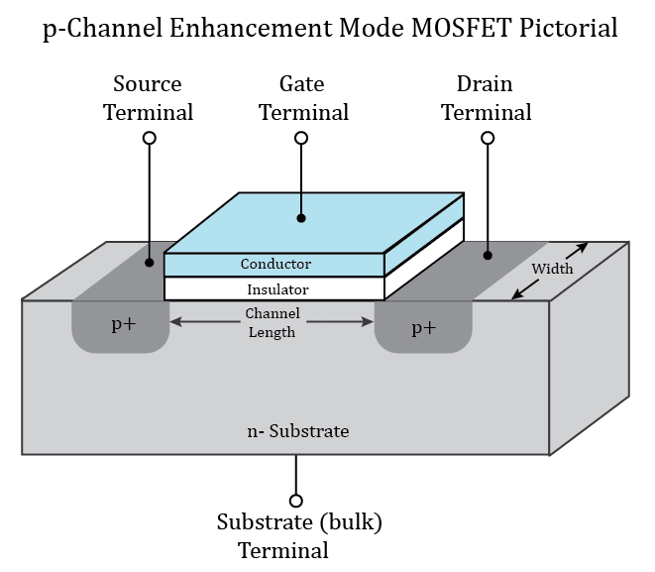
MOSFETs
Metal Oxide Semiconductor Field Effect Transistors (MOSFETs) have four terminals.
Depletion mode MOSFETs have conducting channel with no bias, that can
then be depleted or turned off with an appropriate applied gate-to-source
voltage. Depletion mode MOSFETs have mostly been displaced by n and
p-channel enhancement mode MOSFETs.
Unless told otherwise, assume enhancement mode MOSFETs for ECEN 350.
Enhancement mode MOSFETs have no conducting channel for zero
gate-to-source voltage, with conducting channel formed or enhanced by
appropriate applied gate-to-source voltage.
With no conducting channel formed, enhancement mode MOSFETs are
operating in cutoff, i.e., open switch.
The minimum gate-to-source voltage magnitude necessary to form a
conducting channel for an enhancement mode MOSFET is referred to as the
threshold voltage, V_{T}.
V_{T} is positive for n-channel and negative for p-channel enhancement mode
MOSFETs.

Slide 4
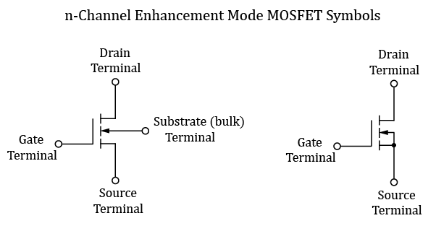
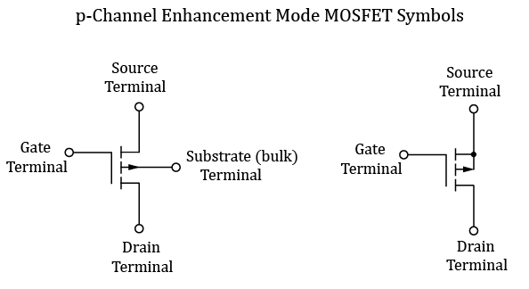
Enhancement Mode MOSFET Symbols
Arrow points from p-substrate to enhanced n-channel for an n-channel enhancement mode MOSFET.
Arrow points from enhanced p-channel to n-substrate for a p-channel enhancement mode MOSFET.
For discrete MOSFETs, such as the STF80N10F7 n-channel MOSFET, or the IRF9540N p-channel MOSFET, the Substrate is connected to Source internally, resulting in a 3-terminal device.

Slide 5
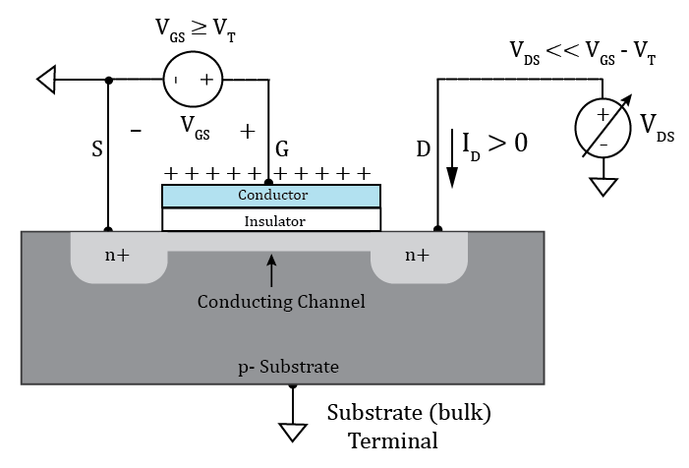
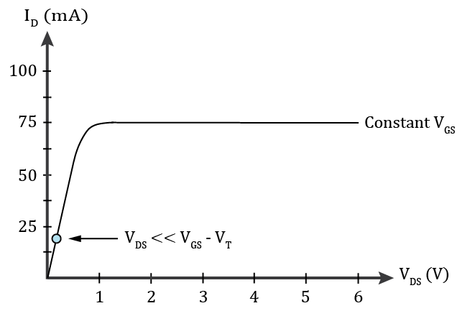
n-channel MOSFET Operation
Heavily doped source and drain regions are good conductors.
For V_{GS} ≥ V_{T}, p- channel region becomes inverted, i.e., majority
carriers become conduction band electrons instead of valence
band holes.
For V_{GS} ≥ V_{T}, conducting channel results in approximately linear
I-V characteristics for small V_{DS}, i.e., V_{DS} << V_{GS} – V_{T}.
This region of MOSFET operation is referred to as the Ohmic region.
MOSFETs behave like a nonlinear resistance in the Ohmic region.
Operating a MOSFET in the ohmic region is common for digital
applications and undesirable for analog applications.
MOSFET data sheets often specify MOSFET on-resistance,
i.e., R_{DS(ON)}, which is the drain-to-source resistance in the ohmic region
for a given gate-to-source voltage greater than V_{T}.
n-Channel Enhancement Mode MOSFET

Slide 6
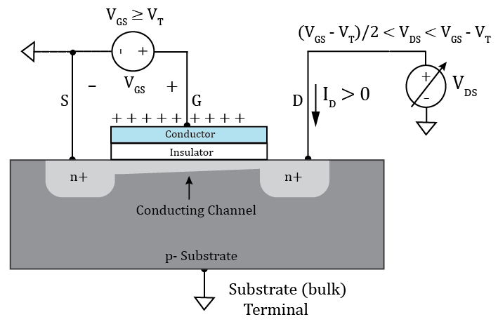
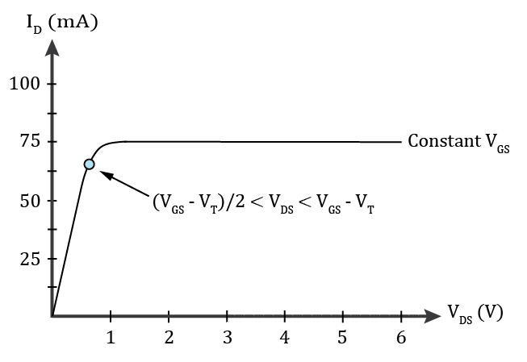
n-channel MOSFET Operation (Continued)
For V_{GS} ≥ V_{T}, increasing V_{DS} results in a reduction of gate-to-drain
voltage at the drain end of the MOSFET, which reduces the conducting
channel at the drain end, causing the I-V characteristics to behave
non-linear because of changing channel resistance.
MOSFETs behave like a nonlinear voltage-controlled resistance
in the Ohmic region.
Some (Micron) refer to the Ohmic region as the Triode region, as
the characteristic is similar to that of Triode vacuum tubes.
n-Channel Enhancement Mode MOSFET

Slide 7
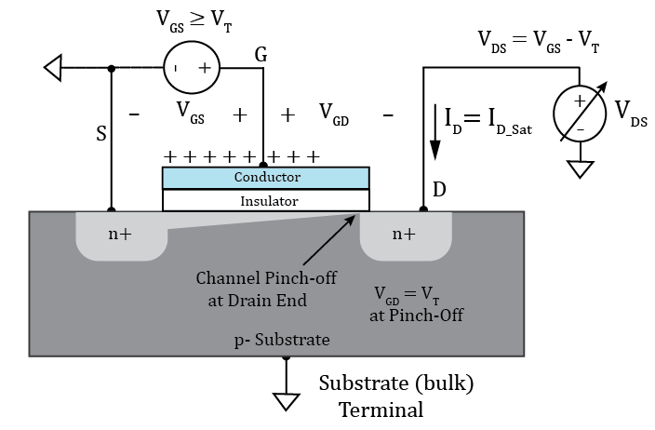
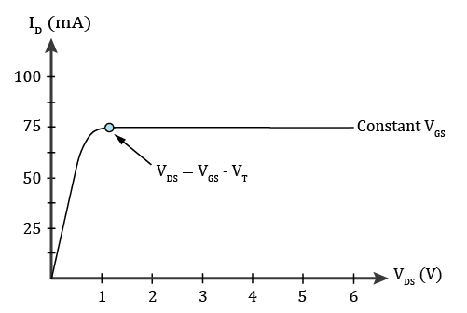
n-channel MOSFET Operation (Continued)
For V_{GS} ≥ V_{T}, increasing V_{DS} eventually results in a gate-to-drain voltage
that exceeds the threshold voltage V_{T}., meaning that there is no longer a
conducting channel at the drain end.
The channel has been pinched off at the drain end, resulting in a change
in the I-V characteristics, referred to as transistor saturation.
MOSFET transistor saturation is characterized by current source behavior
due to channel pinch-off at the drain end.
MOSFET transistor saturation is a completely different phenomena than
BJT circuit saturation.
BJT circuit saturation is characterized by near vertical current variation
at small V_{CE} voltages with the actual current limited by external circuitry.
KVL: -V_{GS} + V_{GD} + V_{DS} = 0. V_{DS} = V_{GS} – V_{GD}. Also, V_{GD} = V_{T} at the onset of
transistor saturation.
Therefore, V_{DS} = V_{GS} - V_{T} is the bias conditions defining the onset of
MOSFET transistor saturation.
n-Channel Enhancement Mode MOSFET

Slide 8
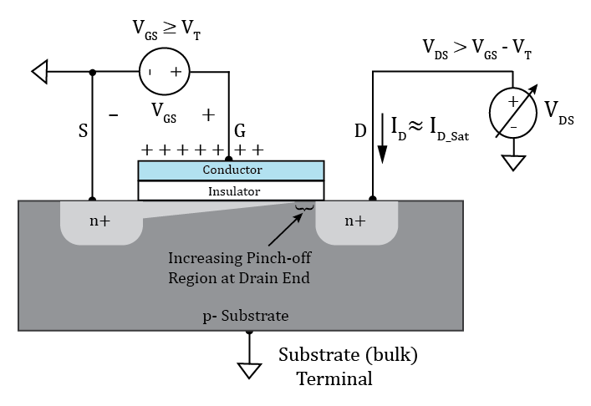
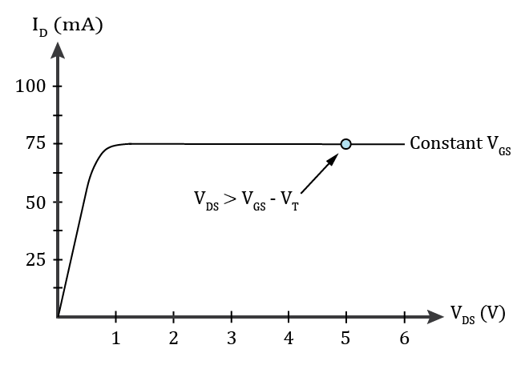
n-channel MOSFET Operation (Continued)
For V_{GS} ≥ V_{T}, increasing V_{DS} beyond V_{GS} – V_{T}, does not increase I_{D} in an
ideal MOSFET, because of channel pinch off.
Practical MOSFETs have some I_{D} increase for increasing V_{DS} beyond
V_{GS} – V_{T} because of widening of the drain depletion region with increasing
reverse bias, referred to as channel length modulation.
Sah’s equations used for hand calculations do not model channel
length modulation.
MOSFETs behave as voltage controlled current sources in the transistor
saturation region with the drain current I_{D} determined by voltage V_{GS}.
MOSFET Transistor Saturation region corresponds to BJT Active region.
MOSFET Ohmic region corresponds to BJT Circuit Saturation region.
n-Channel Enhancement Mode MOSFET

Slide 9
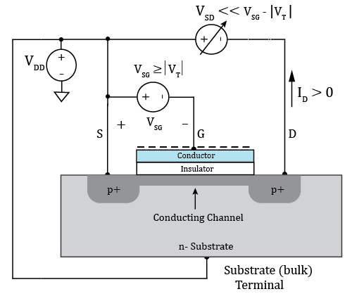
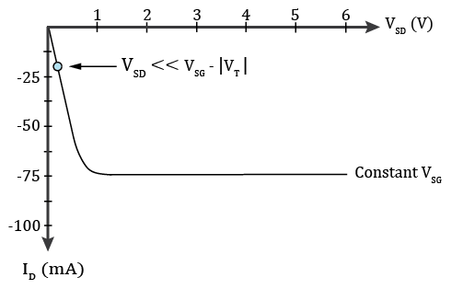
p-channel MOSFET Operation
p-Channel Enhancement Mode MOSFET
The gate voltage needs to be more negative than the source and drain
voltages to form a conducting channel in an enhancement mode p-channel
MOSFET.
For V_{SG} ≥ |V_{T}|, n- channel region becomes inverted, i.e., majority carriers
become valence band holes instead of conduction band electrons.
For V_{SG} ≥ |V_{T}|, conducting channel results in approximately linear I-V
characteristics for small V_{SD}, i.e., V_{SD} << V_{SG} – |V_{T}|.
This region of MOSFET operation is referred to as the Ohmic region.
MOSFETs behave like a nonlinear resistance in the Ohmic region.
Operating a MOSFET in the ohmic region is common for digital
applications and undesirable for analog applications.
MOSFET data sheets often specify MOSFET on-resistance,
i.e, R_{DS(ON)}, which is the drain-to-source resistance in the ohmic region
for a given source-to-gate voltage greater than |V_{T}|.

Slide 10
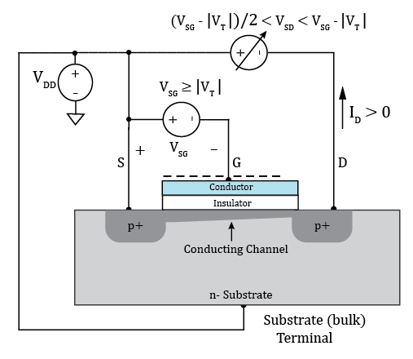
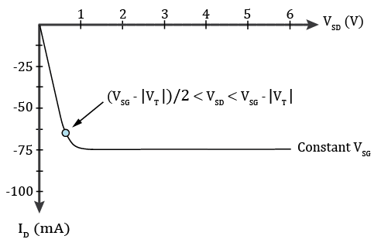
p-channel MOSFET Operation (Continued)
p-Channel Enhancement Mode MOSFET
For V_{SG} ≥ |V_{T}|, increasing V_{SD} results in a reduction of drain-to-gate voltage
at the drain end of the MOSFET, which reduces the conducting channel at the
drain end, causing the I-V characteristics to behave non-linear because of
changing channel resistance.
MOSFETs behave like a nonlinear voltage-controlled resistance in the
Ohmic region.
Some (Micron) refer to the Ohmic region as the Triode region, as the
characteristic is similar to that of Triode vacuum tubes.

Slide 11
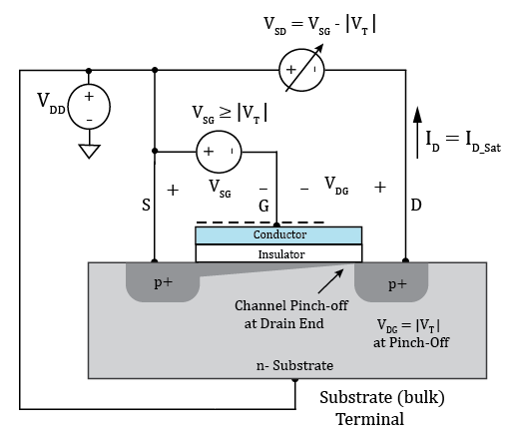
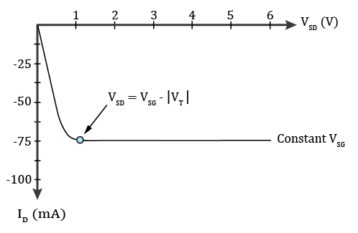
p-channel MOSFET Operation (Continued)
For V_{SG} ≥ |V_{T}|, increasing V_{SD} eventually results in a drain-to-gate voltage
that equals the magnitude of the threshold voltage |V_{T}|, meaning that there is
just barely a conducting channel at the drain end.
The channel has been pinched off at the drain end, resulting in a change in
the I-V characteristics, referred to as saturation.
The MOSFET transistor saturation is defined completely different than BJT
circuit saturation.
MOSFET transistor saturation is characterized by current source behavior
due to channel pinch-off at the drain end.
BJT circuit saturation is characterized by near vertical current
variation at small V_{EC} voltages with the actual current mainly determined
by the external circuitry.
KVL: V_{SG} - V_{DG} - V_{SD} = 0. V_{SD} = V_{SG} – V_{DG}. Also, V_{DG} = |V_{T}| at the onset of
transistor saturation.
Therefore, V_{SD} = V_{SG} - |V_{T}| at the onset of MOSFET transistor saturation.
p-Channel Enhancement Mode MOSFET

Slide 12
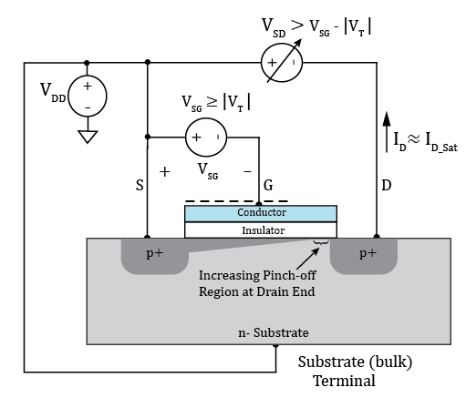
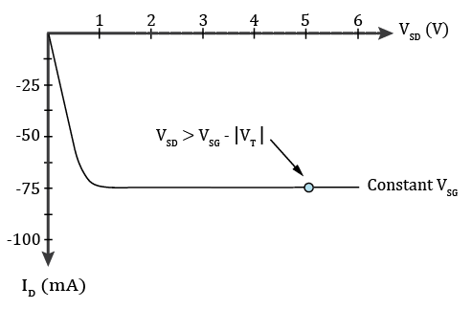
p-channel MOSFET Operation (Continued)
p-Channel Enhancement Mode MOSFET
For V_{SG} ≥ |V_{T}|, increasing V_{SD} beyond V_{SG} - |V_{T}| does not increase I_{D} in an
ideal MOSFET, because of channel pinch off.
Practical MOSFETs have some |I_{D}| increase for increasing V_{SD} beyond
V_{SG} - |V_{T}| because of channel length modulation.
Sah’s equations used for hand calculations do not model channel length
modulation.
MOSFETs behave as voltage controlled current sources in transistor
saturation with the drain current I_{D} determined by voltage V_{SG}.
MOSFET Transistor Saturation region corresponds to BJT Active region.
MOSFET Ohmic region corresponds to BJT Circuit Saturation region.
Poll Questions

Slide 13
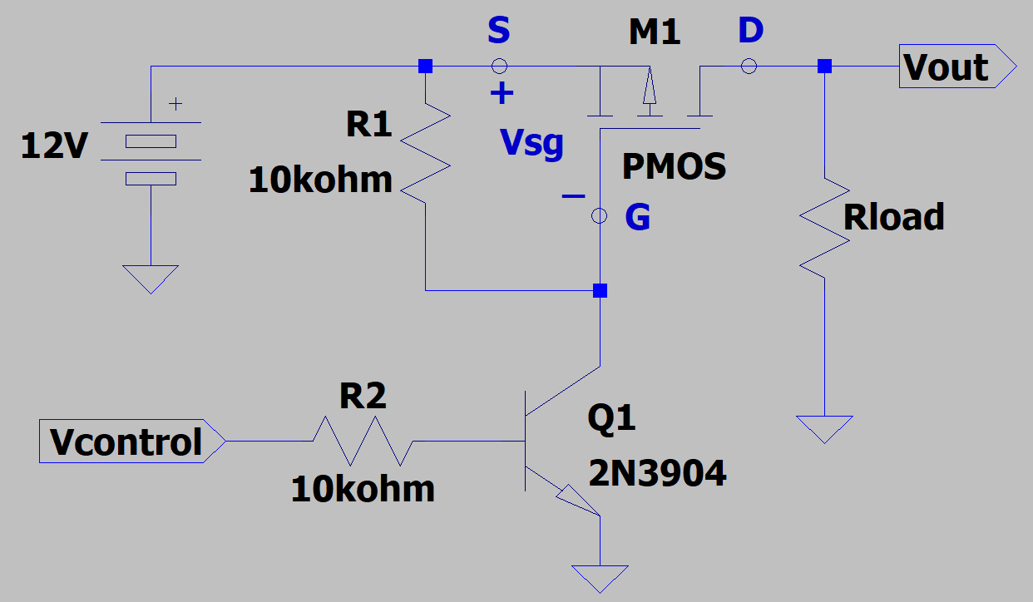
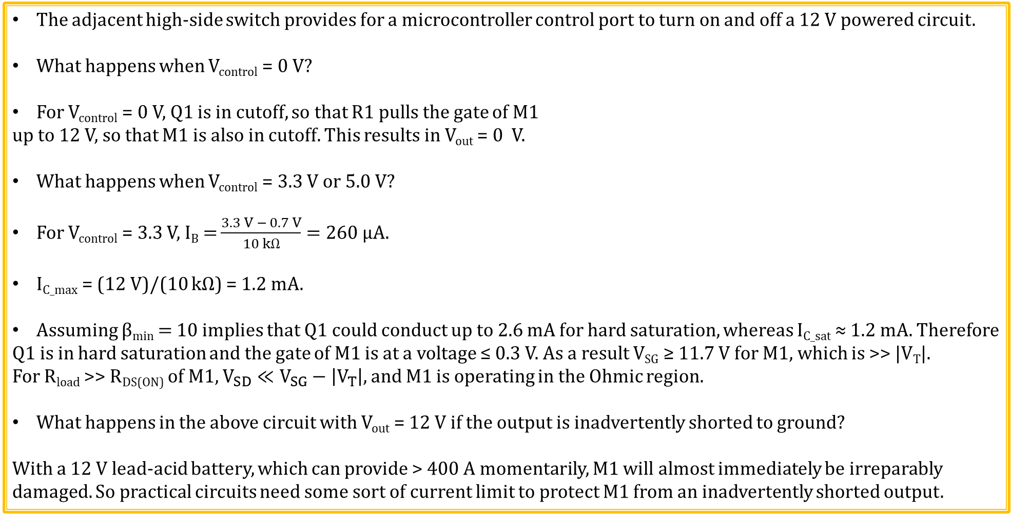
p-channel MOSFET High-Side Switch
The adjacent high-side switch provides for a microcontroller control port to turn on and off a 12 V powered circuit.
What happens when V_{control} = 0 V?
For V_{control} = 0 V, Q1 is in cutoff, so that R1 pulls the gate of M1
up to 12 V, so that M1 is also in cutoff. This results in V_{out} = 0 V.
What happens when V_{control} = 3.3 V or 5.0 V?
For V_{control} = 3.3 V, $\text{I}\text{B}\text{ =}\frac{3.3 V − 0.7 V}{10 kΩ}=260 µA.$
I_{C_max} = (12 V)/(10 kΩ) = 1.2 mA.
Assuming β_{min} = 10 implies that Q1 could conduct up to 2.6 mA for hard saturation, whereas I_{C_sat} ≈ 1.2 mA. Therefore
Q1 is in hard saturation and the gate of M1 is at a voltage ≤ 0.3 V. As a result V_{SG} ≥ 11.7 V for M1, which is >> |V_{T}|.
For R_{load} >> R_{DS(ON)} of M1, $V_{SD}≪V_{SG}−\left|V_{T}\right|,$ and M1 is operating in the Ohmic region.
What happens in the above circuit with V_{out} = 12 V if the output is inadvertently shorted to ground?
With a 12 V lead-acid battery, which can provide > 400 A momentarily, M1 will almost immediately be irreparably damaged. So practical circuits need some sort of current limit to protect M1 from an inadvertently shorted output.

Slide 14
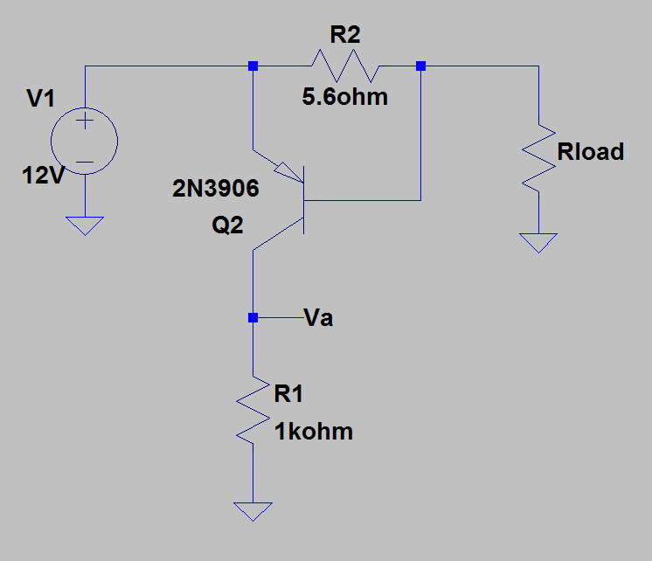
V_{BE} Current Limit using pnp BJT
Q2 is off, and V_{a} ≈ 0 V, for I_{load} < (0.66 V)/R2 < 118 mA.
Q2 is on, and V_{a} ≈ 12 V for I_{load} ≥ (0.66 V)/R2 ≥ 118 mA.
Use V_{a} to turn on and off a switch in order to construct a V_{BE} current limit.
V_{a} is low for current limit off.
V_{a} is high for current limit on.
Need a transistor switch that is on for V_{a_low} and off for V_{a_high}.
A p-channel enhancement-mode MOSFET provides just what
we need.

Slide 15
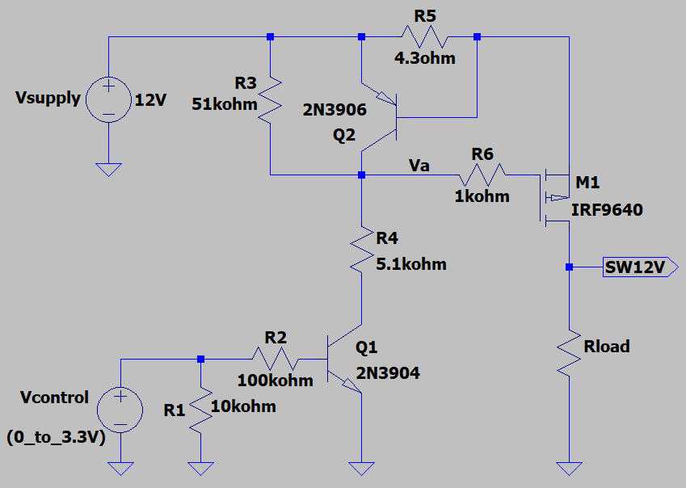
Switched 12 V with Current Limit Lab Utilizes p-channel MOSFET for a Switch
What is the purpose of R6?
Gate protection for MOSFET M1.
What is the resulting current limit?
I_{lim} ≈ (0.66 V)/(4.3 Ω) = 154 mA.
What is the purpose of R1?
To make sure that the circuit quickly
de-energizes the SW12V output if the
V_{control} input is suddenly disconnected.

Slide 16
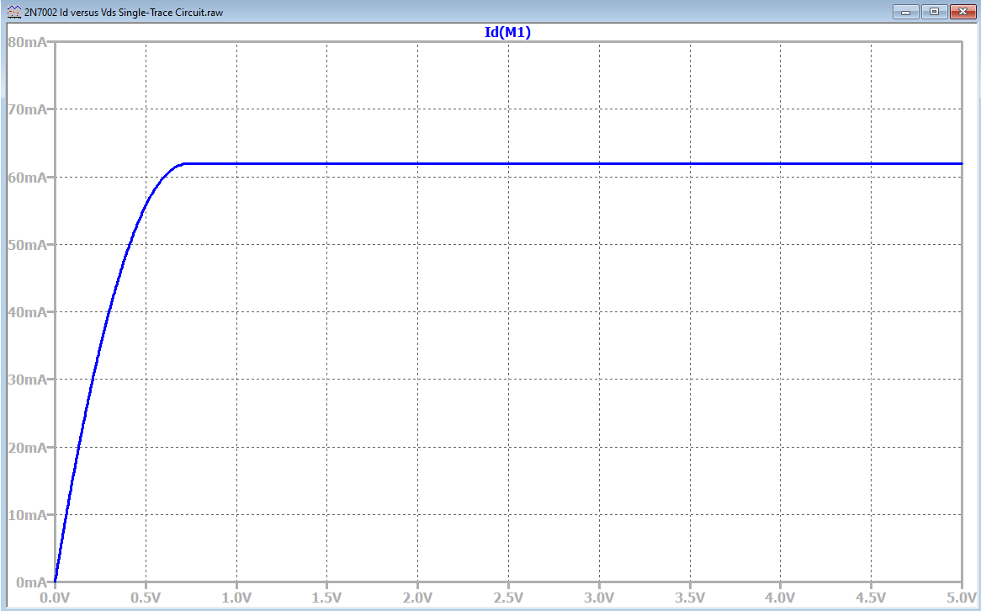
MOSFET Ohmic and Saturation Regions (Continued)
MOSFETs are operated in the Ohmic and cutoff regions for on/off switching applications.
MOSFETs are operated in the Transistor
Saturation or Active region for analog
applications such as current sources and
amplifiers.
MOSFETs behave like a non-linear resistor
in the Ohmic region and like voltage dependent
current source in the Saturation or Active region.
Hence MOSFET Ohmic region corresponds to
BJT Saturation region, and MOSFET Saturation
region corresponds to BJT Active region.
This is inconsistent and confusing, but like
other conventions, such as conventional current
flow, we learn to live with it.
We could just use our Author’s vernacular,
in which he refers to MOSFETs saturation as analogous to BJT circuit saturation, but that could cause unfortunate misunderstandings when talking to MOSFET oriented companies such as Micron, and/or On-Semiconductor.
MOSFET Transistor Saturation or Active Region operation can be approximated as a current source that is dependent upon V_{GS}.
Ohmic or Triode
Region
Transistor Saturation or Active Region

Slide 17
MOSFET Ohmic and Saturation Regions (Continued) (Continued)
Our author refers to the maximum load-line current in the Ohmic Region as the I_{D(sat)}. This is a circuit saturation
versus transistor saturation that occurs because of channel pinch-off .
The maximum load-line current is determined by external circuitry, and not the transistor. For BJTs we approximate the actual current flowing through the transistor in the saturation region as the maximum load-line current, because the two are close in value.
MOSFET transistor saturation is traditionally
defined completely different than what our
author refers to as saturation in the Ohmic
region, which is a Circuit saturation and not a Transistor saturation.
Ohmic or Triode
Region
I_{D_max} in the Saturation (Active) region limited by channel pinch-off for a given V_{GS}, i.e., transistor saturation.
I_{D_max} in the Ohmic region limited by external circuitry, i.e., circuit saturation.
Transistor Saturation
or Active Region
Load Line

Slide 18
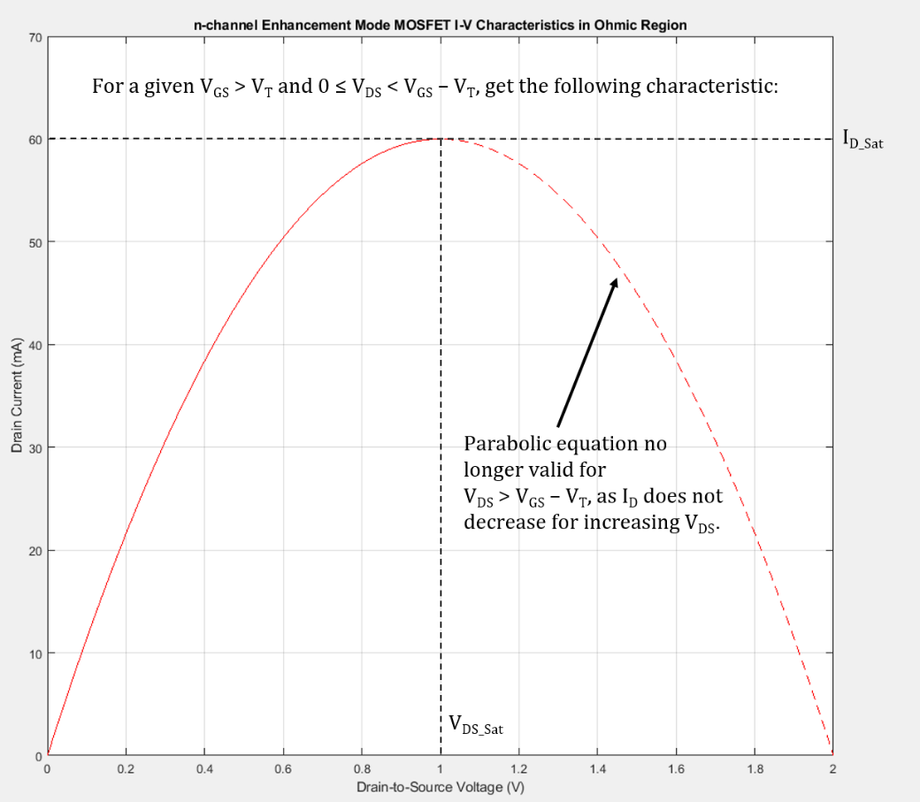
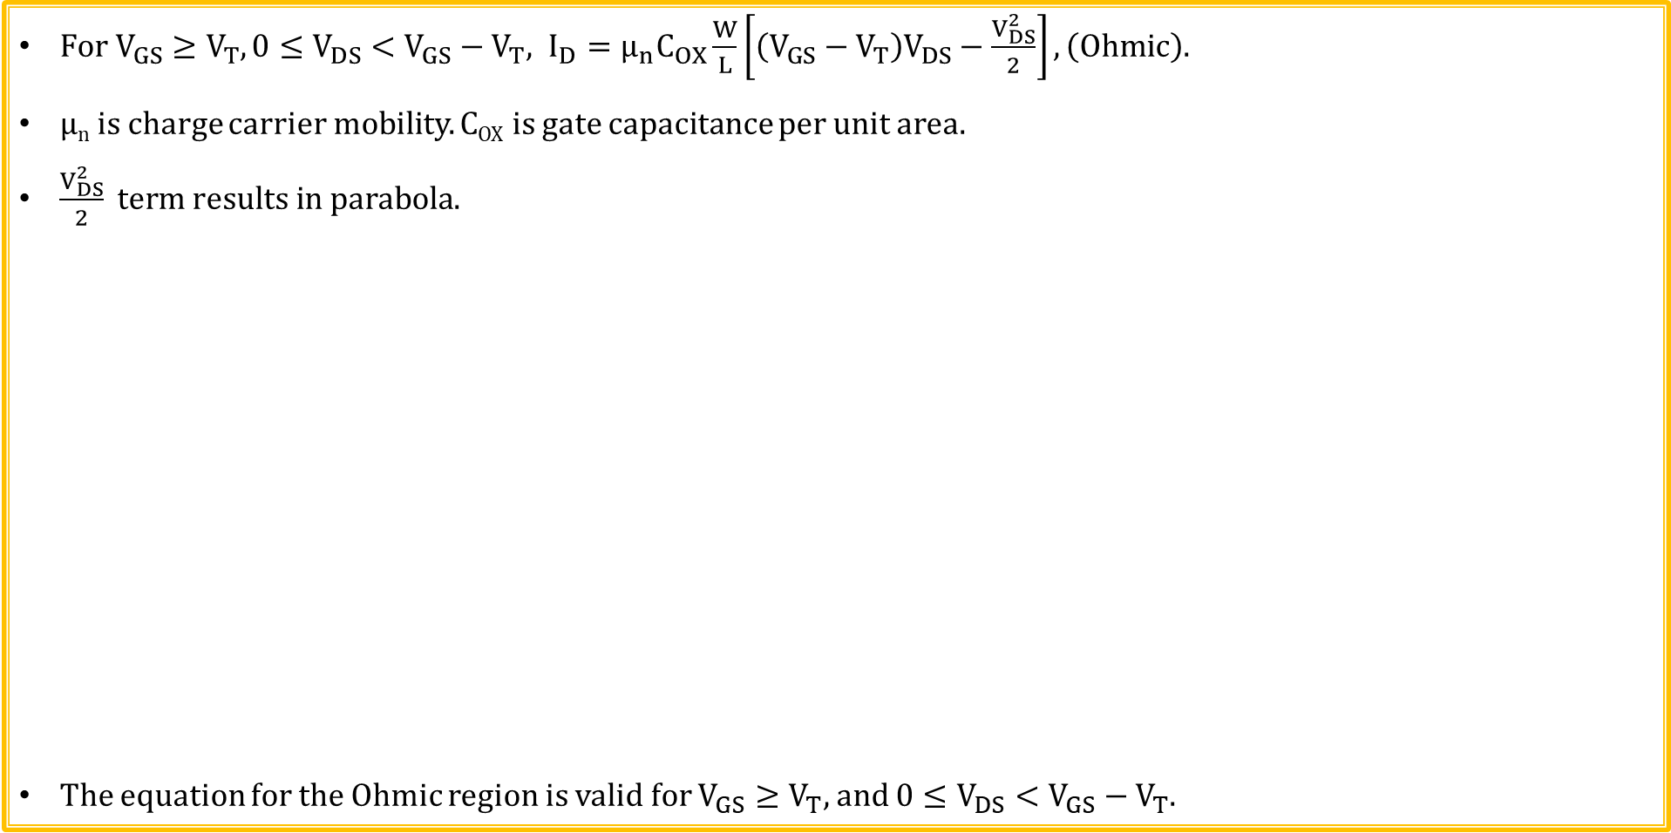
n-channel Enhancement mode MOSFET Drain Current Equation → Ohmic Region
$For V_{GS}≥V_{T}, 0≤V_{DS}<V_{GS}−V_{T}, I_{D}=μ_{n}C_{OX}\frac{W}{L}\left[\left(V_{GS}−V_{T}\right)V_{DS}−\frac{V_{DS}^{2}}{2}\right],\left(Ohmic\right).$
µ_{n} is charge carrier mobility. C_{OX} is gate capacitance per unit area.
$\frac{V_{DS}^{2}}{2} term results in parabola.$
The equation for the Ohmic region is valid for $V_{GS}≥V_{T},$ and $0≤V_{DS}<V_{GS}−V_{T}$.

Slide 19
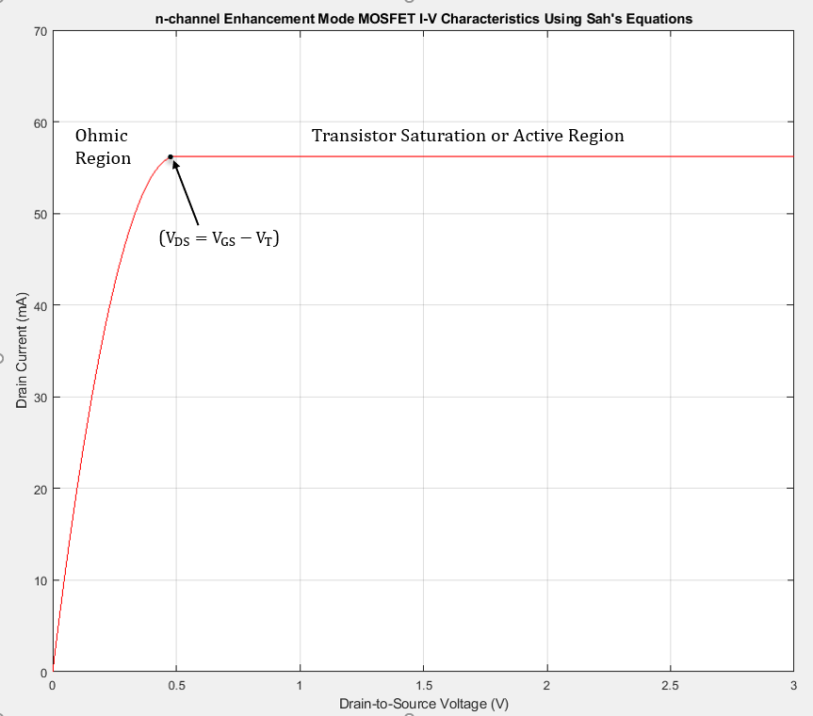
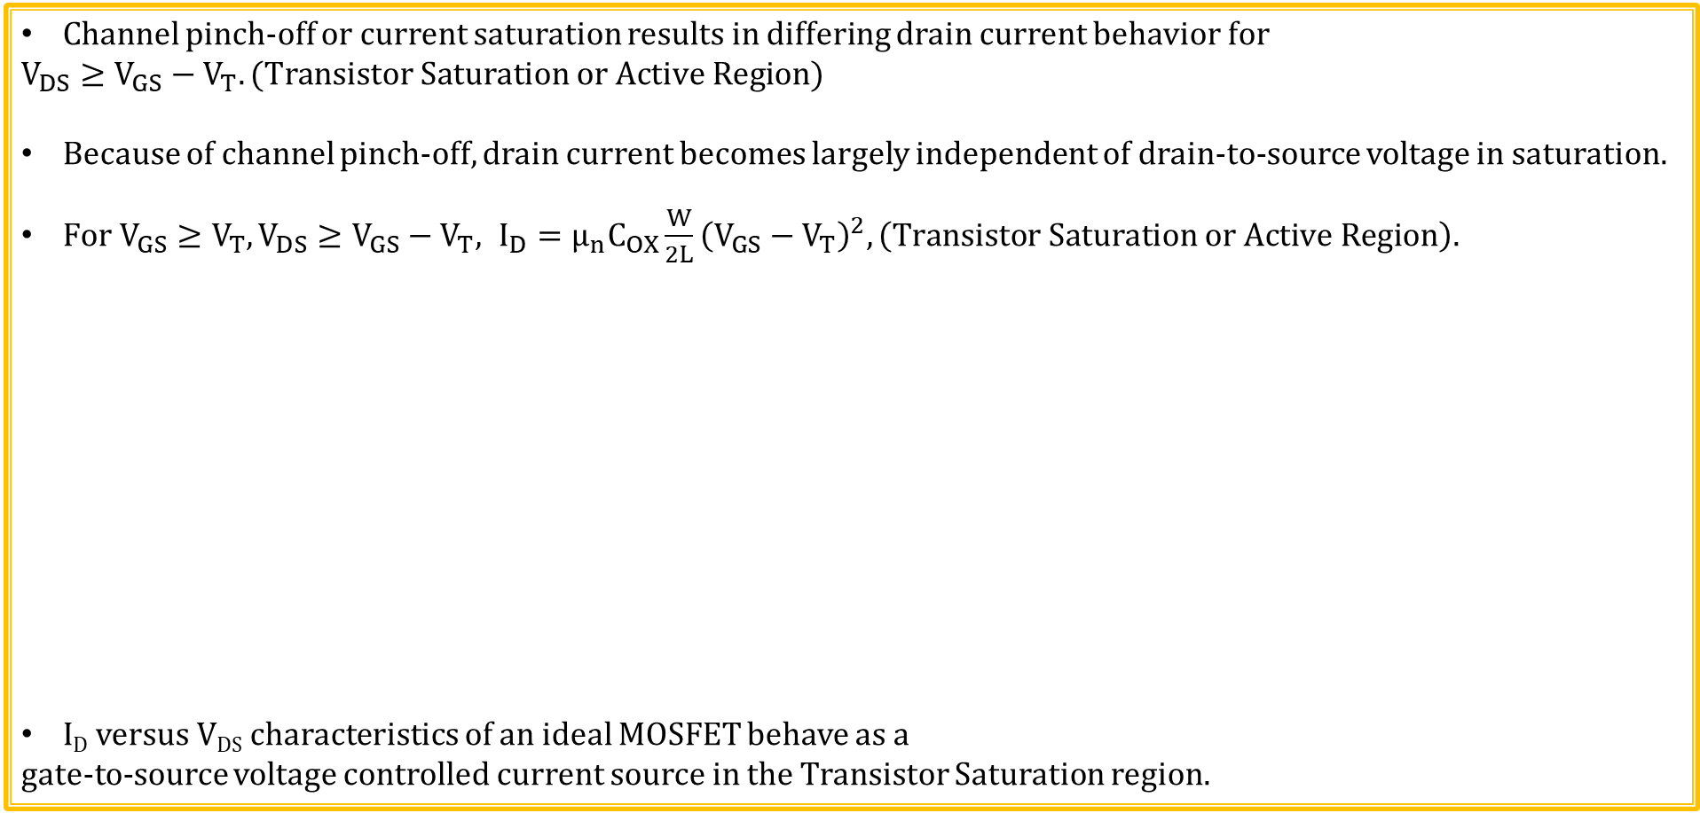
n-channel Enhancement mode MOSFET Drain Current Equation → Transistor Saturation Region
Channel pinch-off or current saturation results in differing drain current behavior for
$$V_{DS}≥V_{GS}−V_{T}. (Transistor Saturation or Active Region)$$
Because of channel pinch-off, drain current becomes largely independent of drain-to-source voltage in saturation.
$For V_{GS}≥V_{T}, V_{DS}≥V_{GS}−V_{T}, I_{D}=μ_{n}C_{OX}\frac{W}{2L}{\left(V_{GS}−V_{T}\right)}^{2},\left(Transistor Saturation or Active Region\right).$
I_{D} versus V_{DS} characteristics of an ideal MOSFET behave as a
gate-to-source voltage controlled current source in the Transistor Saturation region.

Slide 20
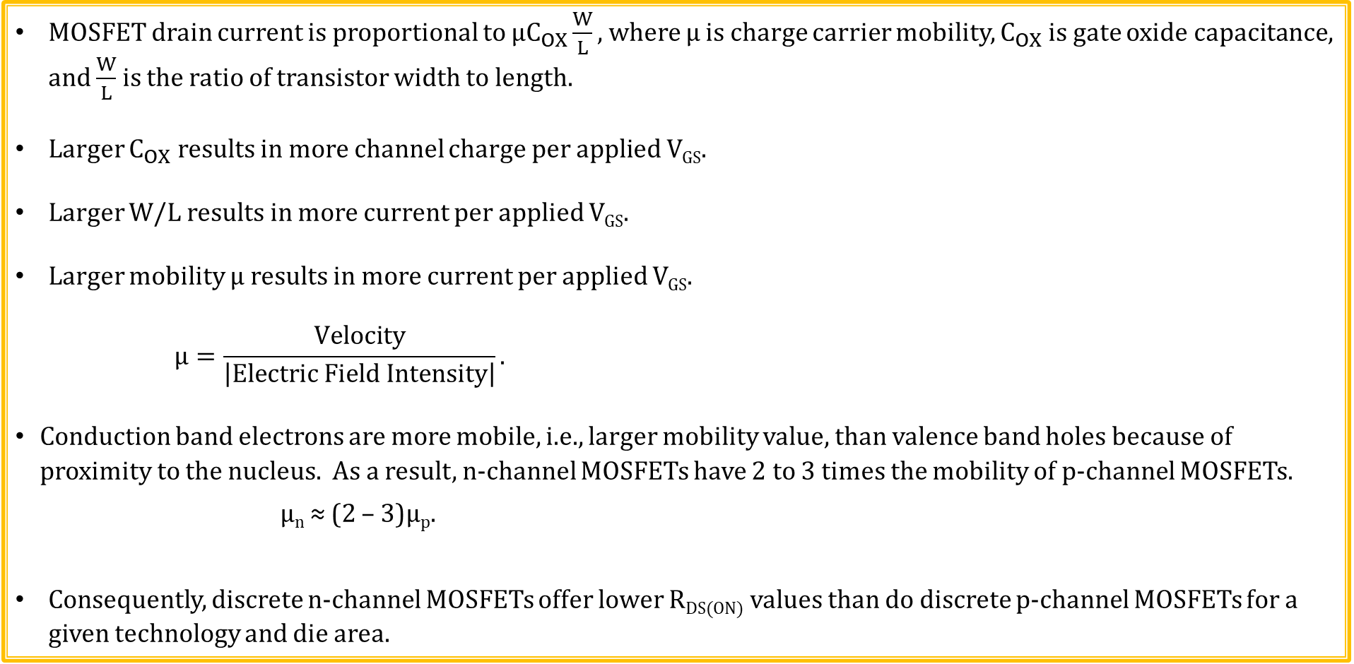
Charge Carrier Mobility - µ
MOSFET drain current is proportional to $μC_{OX}\frac{W}{L},$ where µ is charge carrier mobility, $C_{OX}$ is gate oxide capacitance, and $\frac{W}{L}$ is the ratio of transistor width to length.
Larger $C_{OX}$ results in more channel charge per applied V_{GS}.
Larger W/L results in more current per applied V_{GS}.
Larger mobility µ results in more current per applied V_{GS}.
$$μ=\frac{Velocity}{\left|Electric Field Intensity\right|}.$$
Conduction band electrons are more mobile, i.e., larger mobility value, than valence band holes because of proximity to the nucleus. As a result, n-channel MOSFETs have 2 to 3 times the mobility of p-channel MOSFETs.
µ_{n} ≈ (2 – 3)µ_{p}.
Consequently, discrete n-channel MOSFETs offer lower R_{DS(ON)} values than do discrete p-channel MOSFETs for a given technology and die area.

Slide 21
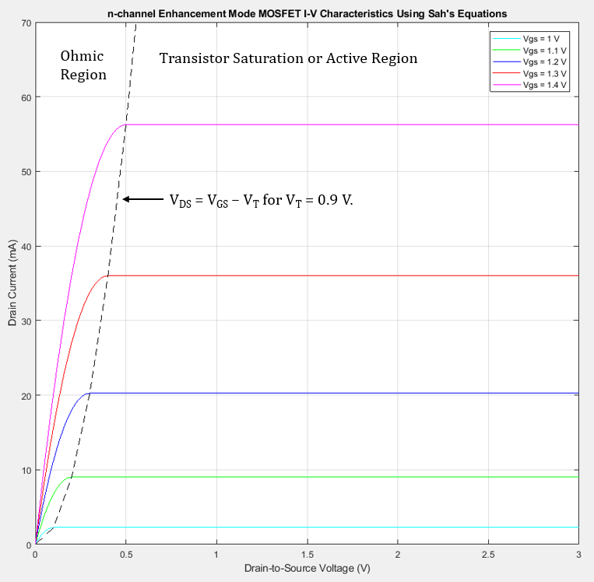
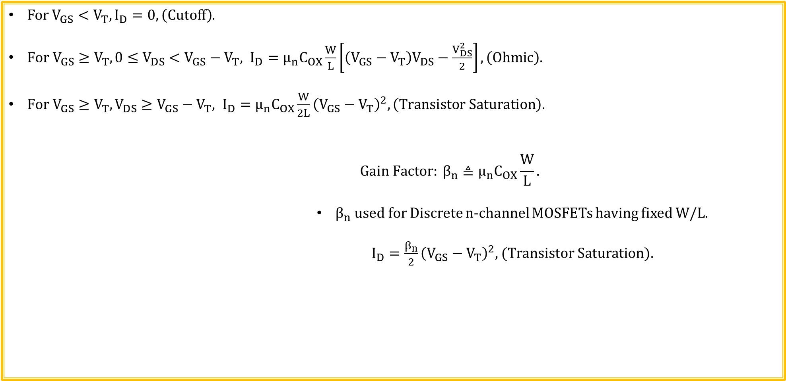
n-channel Enhancement mode MOSFET Drain Current Equations → Sah’s Equations
For $V_{GS}<V_{T},I_{D}=0,\left(Cutoff\right)$.
$For V_{GS}≥V_{T}, 0≤V_{DS}<V_{GS}−V_{T}, I_{D}=μ_{n}C_{OX}\frac{W}{L}\left[\left(V_{GS}−V_{T}\right)V_{DS}−\frac{V_{DS}^{2}}{2}\right],\left(Ohmic\right).$
$For V_{GS}≥V_{T}, V_{DS}≥V_{GS}−V_{T}, I_{D}=μ_{n}C_{OX}\frac{W}{2L}{\left(V_{GS}−V_{T}\right)}^{2},\left(Transistor Saturation\right).$
$$Gain Factor: β_{n}≜μ_{n}C_{OX}\frac{W}{L}.$$
$β_{n}$ used for Discrete n-channel MOSFETs having fixed W/L.
$I_{D}=\frac{β_{n}}{2}{\left(V_{GS}−V_{T}\right)}^{2},$ (Transistor Saturation).

Slide 22
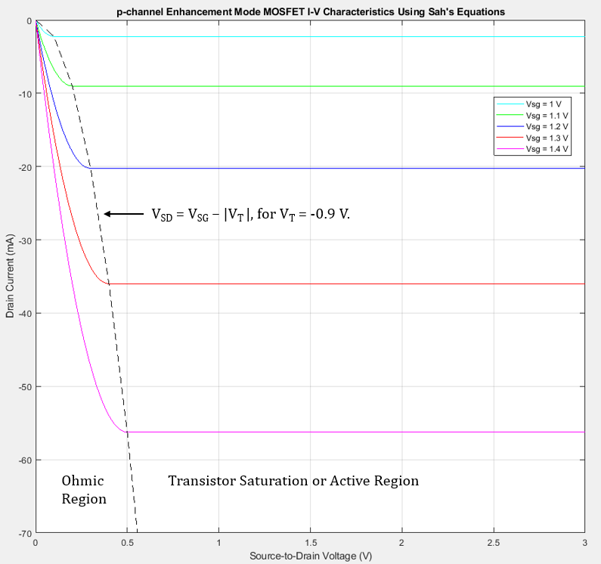
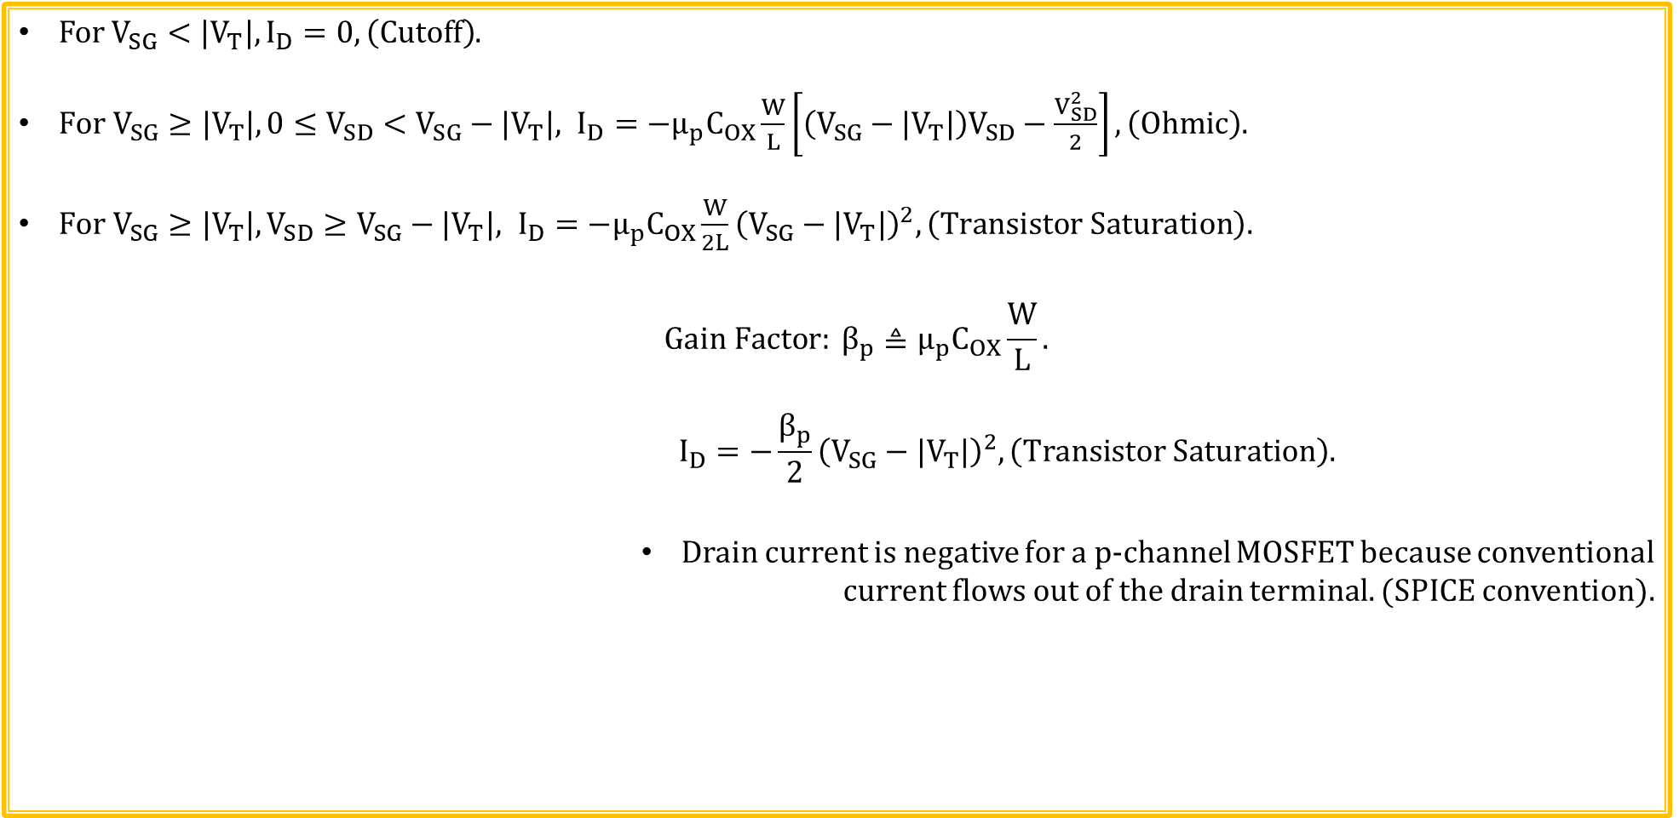
p-channel Enhancement mode MOSFET Drain Current Equations → Sah’s Equations
For $V_{SG}<{|V}_{T}|,I_{D}=0,\left(Cutoff\right)$.
$For V_{SG}≥{|V}_{T}|,0≤V_{SD}<V_{SG}−{|V}_{T}|, I_{D}={−μ}_{p}C_{OX}\frac{W}{L}\left[\left(V_{SG}−{|V}_{T}|\right)V_{SD}−\frac{V_{SD}^{2}}{2}\right],\left(Ohmic\right).$
$For V_{SG}≥{|V}_{T}|, V_{SD}≥V_{SG}−{|V}_{T}|, I_{D}={−μ}_{p}C_{OX}\frac{W}{2L}{\left(V_{SG}−{|V}_{T}|\right)}^{2},\left(Transistor Saturation\right).$
$$Gain Factor: β_{p}≜μ_{p}C_{OX}\frac{W}{L}.$$
$$I_{D}={−\frac{β_{p}}{2}\left(V_{SG}−{|V}_{T}|\right)}^{2},\left(Transistor Saturation\right).$$
Drain current is negative for a p-channel MOSFET because conventional
current flows out of the drain terminal. (SPICE convention).

Slide 23
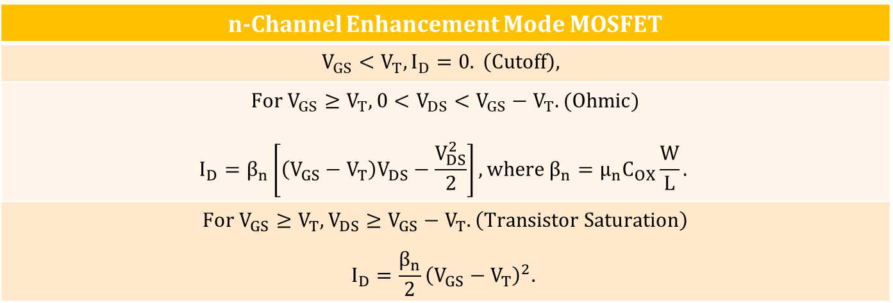
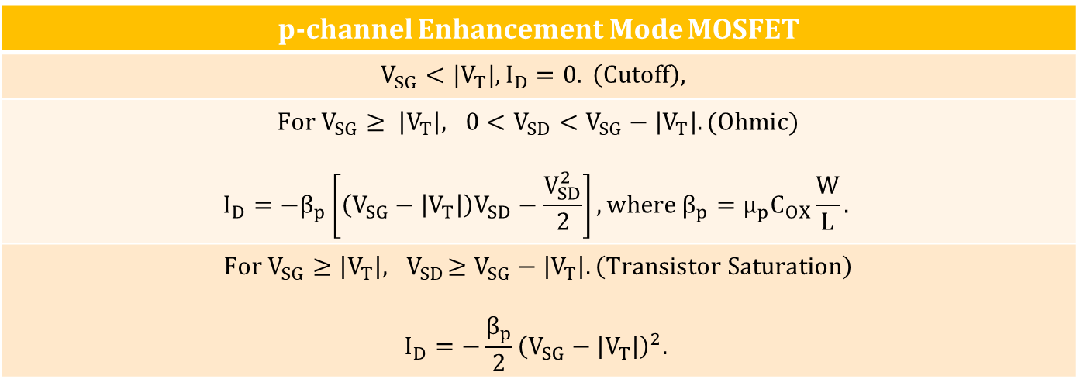
Sah’s Equations for Enhancement Mode MOSFETs
n-Channel Enhancement Mode MOSFET
$$V_{GS}<V_{T}, I_{D}=0. \left(Cutoff\right),$$
$For V_{GS}≥V_{T}, 0<V_{DS}<V_{GS}−V_{T}. (Ohmic)$ $$I_{D}=β_{n}\left[\left(V_{GS}−V_{T}\right)V_{DS}−\frac{V_{DS}^{2}}{2}\right], where β_{n}=μ_{n}C_{OX}\frac{W}{L}.$$
$$For V_{GS}≥V_{T}, V_{DS}≥V_{GS}−V_{T}. \left(Transistor Saturation\right)$$ $$I_{D}=\frac{β_{n}}{2}{\left(V_{GS}−V_{T}\right)}^{2}.$$
p-channel Enhancement Mode MOSFET
$$V_{SG}<{|V}_{T}|, I_{D}=0. \left(Cutoff\right),$$
$For V_{SG}≥ \left|V_{T}\right|, 0<V_{SD}<V_{SG}−\left|V_{T}\right|. (Ohmic)$ $$I_{D}={−β}_{p}\left[\left(V_{SG}−\left|V_{T}\right|\right)V_{SD}−\frac{V_{SD}^{2}}{2}\right], where β_{p}=μ_{p}C_{OX}\frac{W}{L}.$$
$$For V_{SG}≥\left|V_{T}\right|, { V}_{SD}≥V_{SG}−\left|V_{T}\right|. \left(Transistor Saturation\right)$$ $$I_{D}=−\frac{β_{p}}{2}{\left(V_{SG}−\left|V_{T}\right|\right)}^{2}.$$

Slide 24
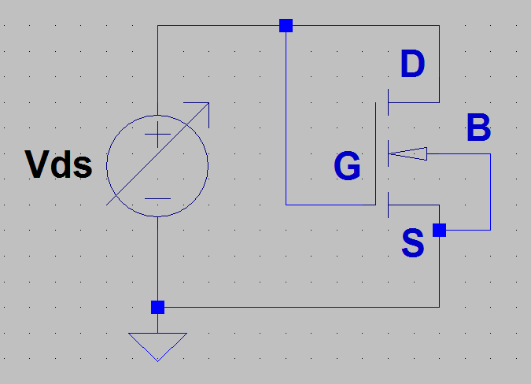
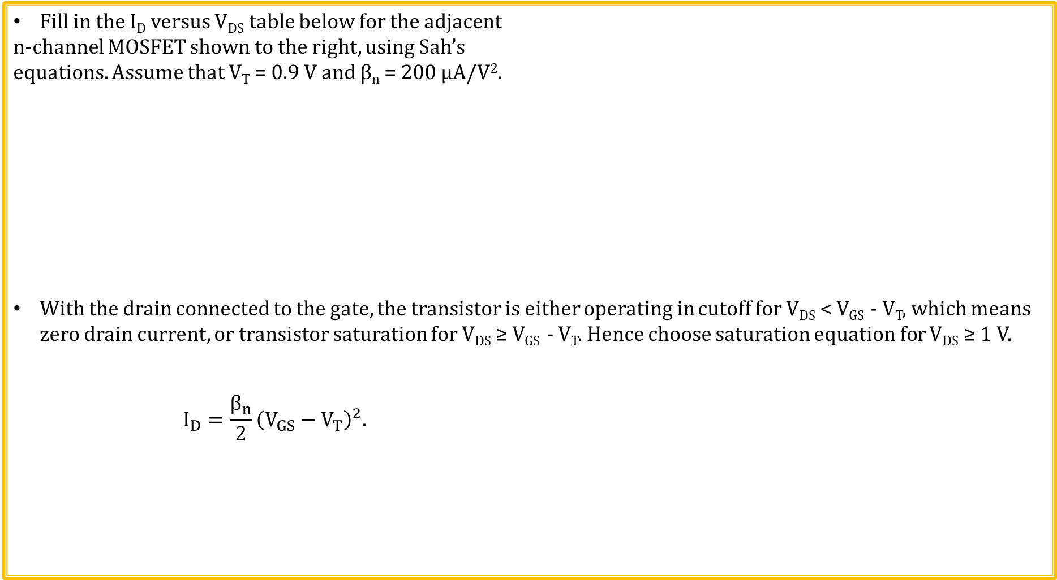
n-channel MOSFET Example 1
Fill in the I_{D} versus V_{DS} table below for the adjacent
n-channel MOSFET shown to the right, using Sah’s
equations. Assume that V_{T} = 0.9 V and β_{n} = 200 µA/V².
With the drain connected to the gate, the transistor is either operating in cutoff for V_{DS} < V_{GS} - V_{T}, which means zero drain current, or transistor saturation for V_{DS} ≥ V_{GS} - V_{T}. Hence choose saturation equation for V_{DS} ≥ 1 V.
$$I_{D}=\frac{β_{n}}{2}{\left(V_{GS}−V_{T}\right)}^{2}.$$
V_{DS} (V) | I_{D}
0
1
2
3
4
5
V_{DS} (V) | I_{D}
0 | 0 µA
1 | 1 µA
2 | 121 µA
3 | 441 µA
4 | 961 µA
5 | 1.68 mA

Slide 25
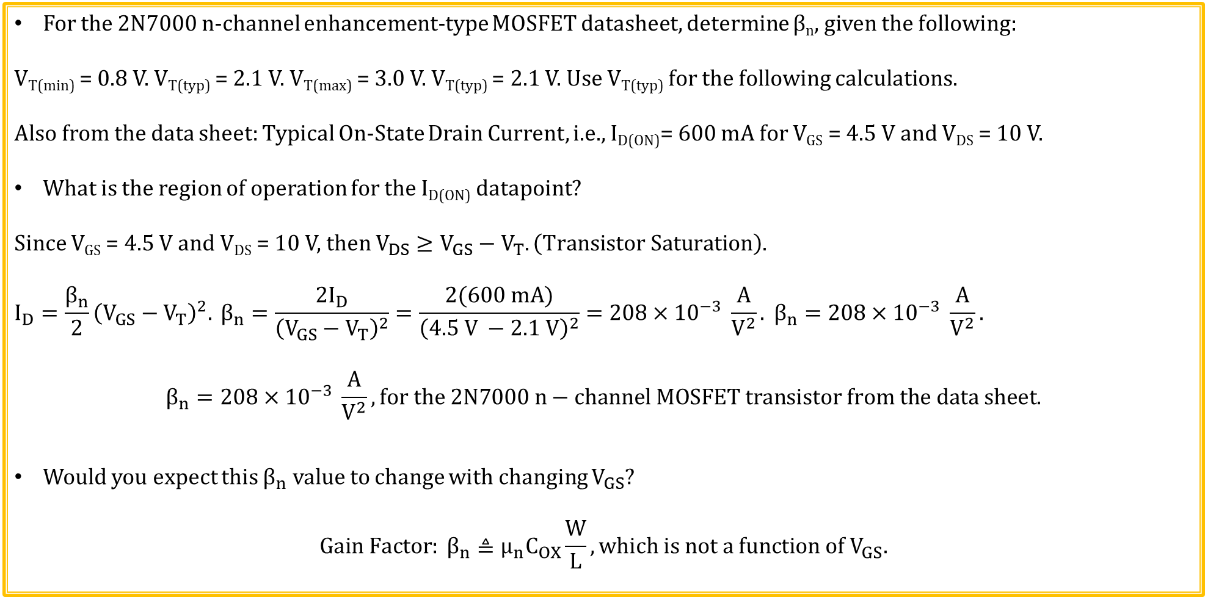
n-channel MOSFET Example 2
For the 2N7000 n-channel enhancement-type MOSFET datasheet, determine β_{n}, given the following:
V_{T(min)} = 0.8 V. V_{T(typ)} = 2.1 V. V_{T(max)} = 3.0 V. V_{T(typ)} = 2.1 V. Use V_{T(typ)} for the following calculations.
Also from the data sheet: Typical On-State Drain Current, i.e., I_{D(ON)}= 600 mA for V_{GS} = 4.5 V and V_{DS} = 10 V.
What is the region of operation for the I_{D(ON)} datapoint?
Since V_{GS} = 4.5 V and V_{DS} = 10 V, then $V_{DS}≥V_{GS}−V_{T}. \left(Transistor Saturation\right)$.
$$I_{D}=\frac{β_{n}}{2}{\left(V_{GS}−V_{T}\right)}^{2}. β_{n}=\frac{2I_{D}}{{\left(V_{GS}−V_{T}\right)}^{2}}=\frac{2(600 mA)}{{\left(4.5 V −2.1 V\right)}^{2}}=208×{10}^{−3} \frac{A}{V^{2}}. β_{n}=208×{10}^{−3} \frac{A}{V^{2}}.$$
$$β_{n}=208×{10}^{−3} \frac{A}{V^{2}}, for the 2N7000 n−channel MOSFET transistor from the data sheet.$$
Would you expect this $β_{n}$ value to change with changing $V_{GS}$?
$$Gain Factor: β_{n}≜μ_{n}C_{OX}\frac{W}{L}, which is not a function of V_{GS}.$$

Slide 26
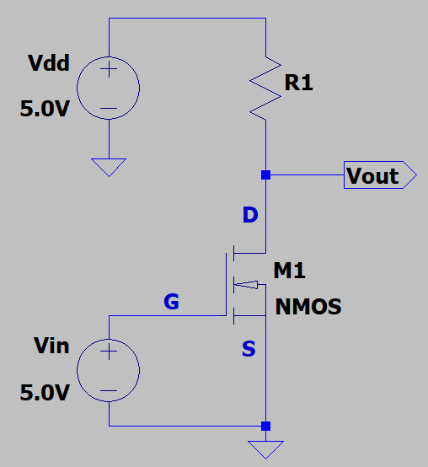
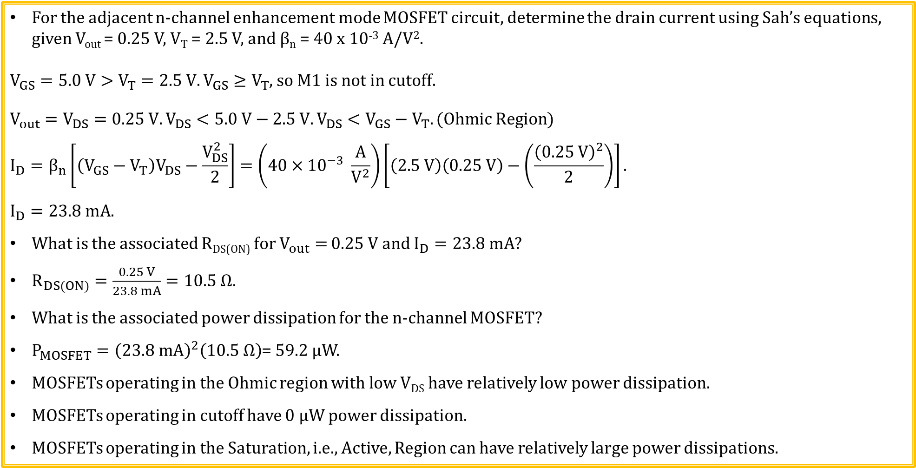
n-channel MOSFET Example 3
For the adjacent n-channel enhancement mode MOSFET circuit, determine the drain current using Sah’s equations, given V_{out} = 0.25 V, V_{T} = 2.5 V, and β_{n} = 40 x 10⁻³ A/V².
$V_{GS}=5.0 V>V_{T}=2.5 V. V_{GS}≥V_{T}$, so M1 is not in cutoff.
$V_{out}=V_{DS}=0.25 V.V_{DS}<5.0 V−2.5 V. V_{DS}<V_{GS}−V_{T}. (Ohmic Region)$
$$I_{D}=β_{n}\left[\left(V_{GS}−V_{T}\right)V_{DS}−\frac{V_{DS}^{2}}{2}\right]=\left(40×{10}^{−3} \frac{A}{V^{2}}\right)\left[\left(2.5 V\right)\left(0.25 V\right)−\left(\frac{{\left(0.25 V\right)}^{2}}{2}\right)\right].$$
$$I_{D}=23.8 mA.$$
What is the associated R_{DS(ON)} for $V_{out}=$ 0.25 V and $I_{D}=23.8 mA?$
$R_{DS(ON)}=\frac{0.25 V}{23.8 mA}=10.5 Ω.$
What is the associated power dissipation for the n-channel MOSFET?
$P_{MOSFET}={\left(23.8 mA\right)}^{2}\left(10.5 Ω\right)$= 59.2 µW.
MOSFETs operating in the Ohmic region with low V_{DS} have relatively low power dissipation.
MOSFETs operating in cutoff have 0 µW power dissipation.
MOSFETs operating in the Saturation, i.e., Active, Region can have relatively large power dissipations.
Poll Questions

Slide 27
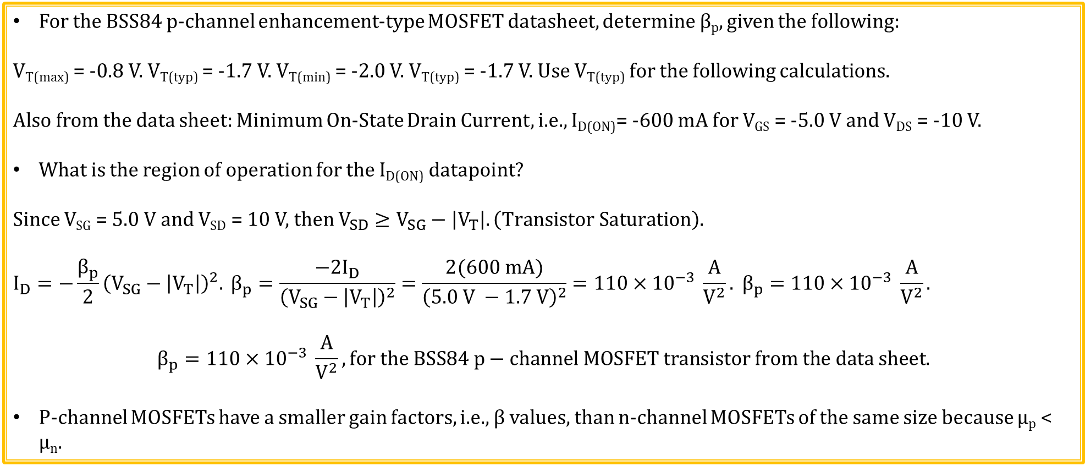
p-channel MOSFET Example 1
For the BSS84 p-channel enhancement-type MOSFET datasheet, determine β_{p}, given the following:
V_{T(max)} = -0.8 V. V_{T(typ)} = -1.7 V. V_{T(min)} = -2.0 V. V_{T(typ)} = -1.7 V. Use V_{T(typ)} for the following calculations.
Also from the data sheet: Minimum On-State Drain Current, i.e., I_{D(ON)}= -600 mA for V_{GS} = -5.0 V and V_{DS} = -10 V.
What is the region of operation for the I_{D(ON)} datapoint?
Since V_{SG} = 5.0 V and V_{SD} = 10 V, then $V_{SD}≥V_{SG}−\left|V_{T}\right|. \left(Transistor Saturation\right)$.
$$I_{D}=−\frac{β_{p}}{2}{\left(V_{SG}−\left|V_{T}\right|\right)}^{2}. β_{p}=\frac{−2I_{D}}{{\left(V_{SG}−\left|V_{T}\right|\right)}^{2}}=\frac{2(600 mA)}{{\left(5.0 V −1.7 V\right)}^{2}}=110×{10}^{−3} \frac{A}{V^{2}}. β_{p}=110×{10}^{−3} \frac{A}{V^{2}}.$$
$$β_{p}=110×{10}^{−3} \frac{A}{V^{2}}, for the BSS84 p−channel MOSFET transistor from the data sheet.$$
P-channel MOSFETs have a smaller gain factors, i.e., β values, than n-channel MOSFETs of the same size because µ_{p} < µ_{n}.

Slide 28
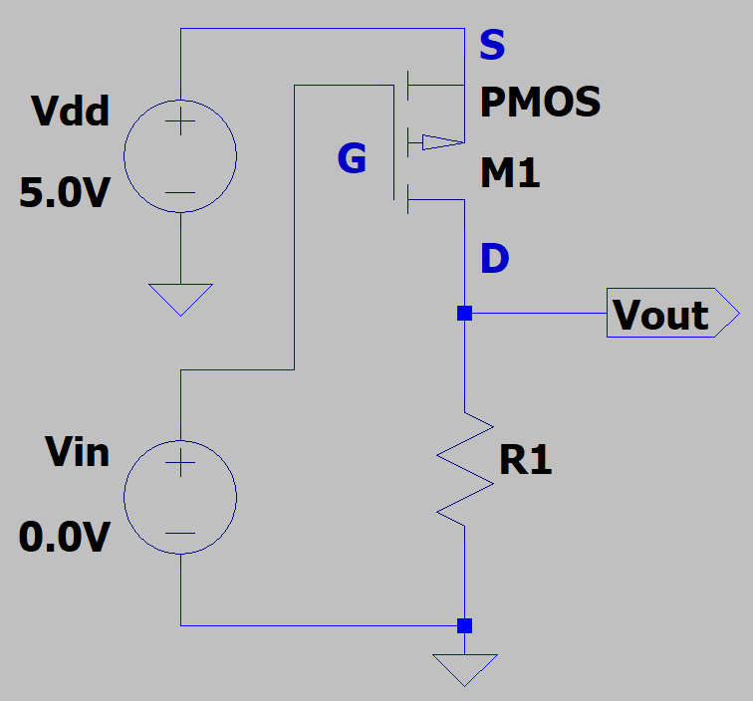
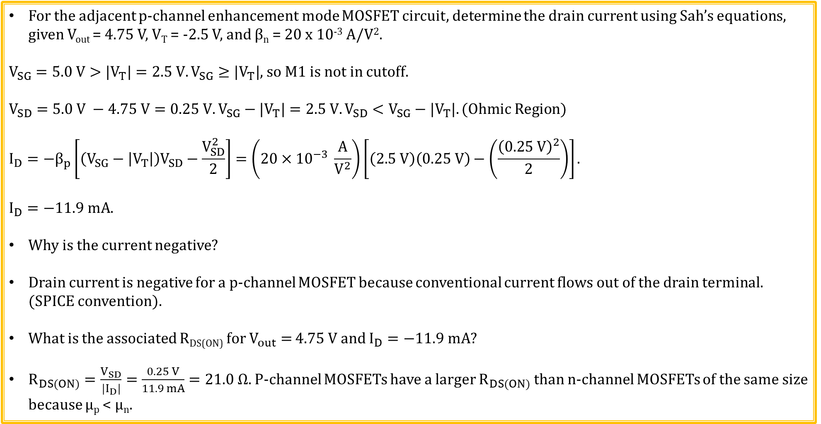
p-channel MOSFET Example 2
For the adjacent p-channel enhancement mode MOSFET circuit, determine the drain current using Sah’s equations, given V_{out} = 4.75 V, V_{T} = -2.5 V, and β_{n} = 20 x 10⁻³ A/V².
$V_{SG}=5.0 V>{|V}_{T}|=2.5 V. V_{SG}≥{|V}_{T}|$, so M1 is not in cutoff.
$$V_{SD}=5.0 V −4.75 V=0.25 V. V_{SG}−{|V}_{T}|=2.5 V.V_{SD}<V_{SG}−{|V}_{T}|. (Ohmic Region)$$
$$I_{D}={−β}_{p}\left[\left(V_{SG}−\left|V_{T}\right|\right)V_{SD}−\frac{V_{SD}^{2}}{2}\right]=\left(20×{10}^{−3} \frac{A}{V^{2}}\right)\left[\left(2.5 V\right)\left(0.25 V\right)−\left(\frac{{\left(0.25 V\right)}^{2}}{2}\right)\right].$$
$$I_{D}=−11.9 mA.$$
Why is the current negative?
Drain current is negative for a p-channel MOSFET because conventional current flows out of the drain terminal. (SPICE convention).
What is the associated R_{DS(ON)} for $V_{out}=$ 4.75 V and $I_{D}=−11.9 mA?$
$R_{DS(ON)}=\frac{V_{SD}}{{|I}_{D}|}=\frac{0.25 V}{11.9 mA}=21.0 Ω.$P-channel MOSFETs have a larger $R_{DS(ON)}$ than n-channel MOSFETs of the same size because µ_{p} < µ_{n}.

Slide 29
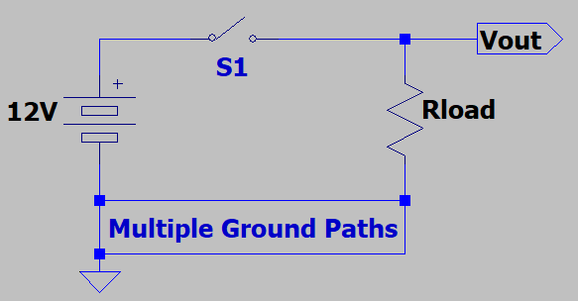
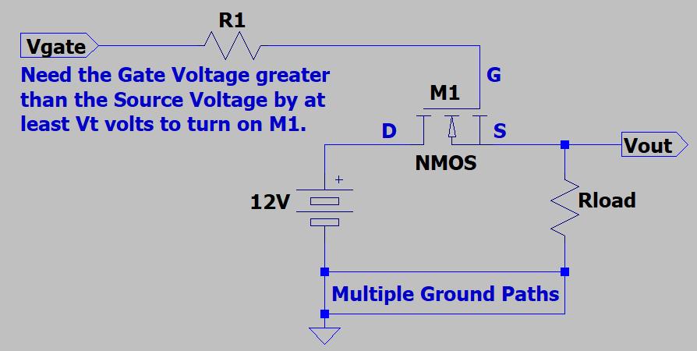
High-Side Switch
Low-power is often achieved by turning off the power when not needed
in battery powered applications by means of a microcontroller.
Hence, battery powered loads often need to be turned on/off to preserve
battery life.
High side switch is preferred as multiple ground return paths are
possible due to sensor cable shields, etc., making a low-side switch
undesirable.
Also a high-side switch de-energizes the load during power down, which in general is a safer state.
E-MOSFETs operating in the Ohmic region make good high-side switches.
Yet n-channel MOSFETs require a gate voltage that is at least V_{T} above
the source voltage to close the switch, i.e. turn on the transistor.
Hence, the required gate voltage for an n-channel high-side MOSFET
switch is not readily available in many applications.
Special charge-pump switching circuitry is sometimes used to generate the necessary gate voltages for n-channel high-side switches. Yet a simpler approach is to use a p-channel MOSFET for high-side switch applications.

Slide 30
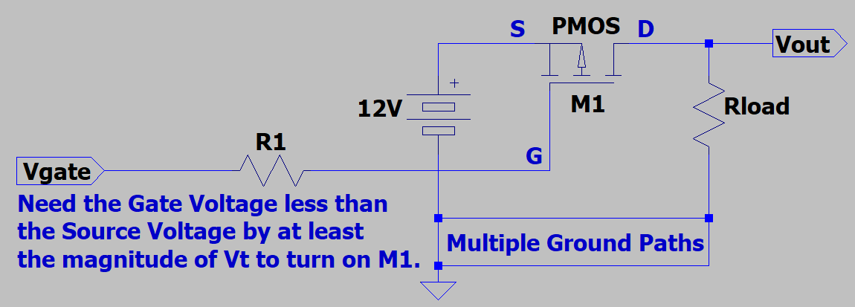
High-Side Switch (Continued)
P-channel MOSFETs are often used for
high-side switch applications.
Pulling the gate voltage to near ground will
turn on the MOSFET, while pulling the gate
voltage to near 12 V will turn it off.
For the gate voltage near ground and
R_{DS(ON)} << R_{load}, the p-channel MOSFET will be
operating in the Ohmic region, resulting in low MOSFET power dissipation and V_{out} ≈ 12 V.
For example, the surface-mount FDC5614P p-channel MOSFET offers a maximum R_{DS(ON)} = 0.105 Ω for V_{SG} = 10 V.
Assuming R_{DS(ON)} = 0.105 Ω and R_{load} = 24 Ω, what is the power dissipation of the MOSFET M1 in the above 12 V circuit?
I_{Load} = (12 V)/(24.1 Ω) = 0.498 A. P_{MOSFET} = (0.498 A)²(0.105 Ω) = 26 mW. P_{MOSFET} = 26 mW which is negligible.
Resistor R1 is a gate protection resistor, protecting the sensitive insulated gate from damage from an Electrostatic Discharge (ESD) applied to the gate control terminal.
How much dc current flows through resistor R1?
0.0 mA. Therefore, there is no voltage drop across R1, such that the full voltage at V_{gate} gets applied to the MOSFET.

Slide 31
Switched 12 V with Current Limit Lab Utilizes p-channel MOSFET for a Switch
What is the purpose of R6?
Gate protection for MOSFET M1.
What is the resulting current limit?
I_{lim} ≈ (0.66 V)/(4.3 Ω) = 154 mA.
What is the purpose of R1?
To make sure that the circuit quickly
de-energizes the SW12V output if the
V_{control} input is suddenly disconnected.

Slide 32
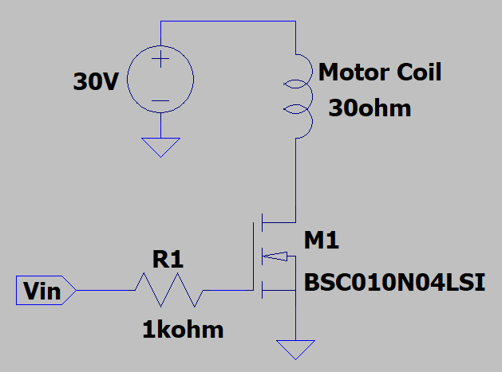
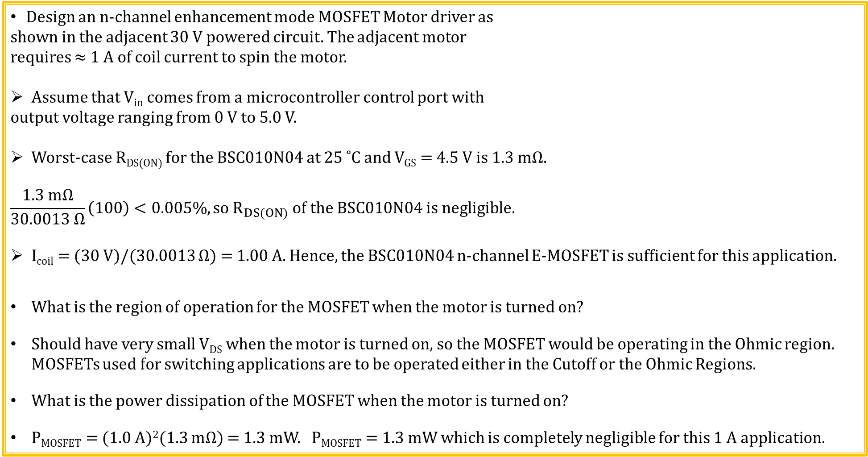
n-channel MOSFET Motor Driver
Design an n-channel enhancement mode MOSFET Motor driver as
shown in the adjacent 30 V powered circuit. The adjacent motor
requires ≈ 1 A of coil current to spin the motor.
Assume that V_{in} comes from a microcontroller control port with
output voltage ranging from 0 V to 5.0 V.
Worst-case R_{DS(ON)} for the BSC010N04 at 25 ˚C and V_{GS} = 4.5 V is 1.3 mΩ.
$$\frac{1.3 mΩ}{30.0013 Ω}\left(100\right)<0.005\%, so R_{DS(ON)} of the BSC010N04 is negligible.$$
I_{coil} = (30 V)/(30.0013 Ω) = 1.00 A. Hence, the BSC010N04 n-channel E-MOSFET is sufficient for this application.
What is the region of operation for the MOSFET when the motor is turned on?
Should have very small V_{DS} when the motor is turned on, so the MOSFET would be operating in the Ohmic region. MOSFETs used for switching applications are to be operated either in the Cutoff or the Ohmic Regions.
What is the power dissipation of the MOSFET when the motor is turned on?
P_{MOSFET} = (1.0 A)²(1.3 mΩ) = 1.3 mW. P_{MOSFET} = 1.3 mW which is completely negligible for this 1 A application.

Slide 33
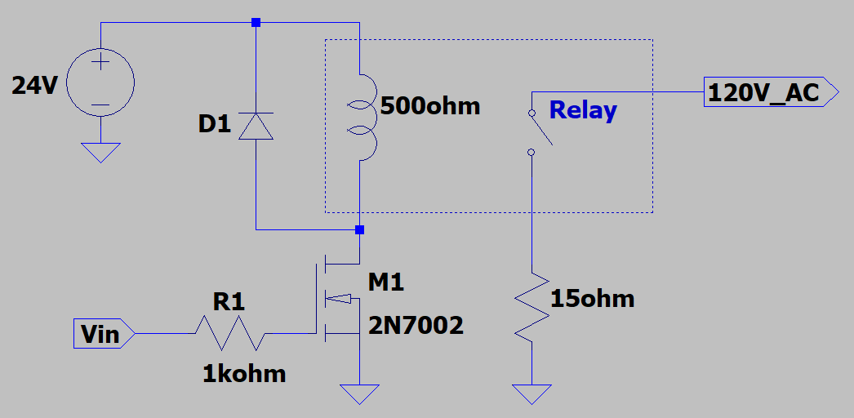

n-channel MOSFET Relay Driver
Design an n-channel enhancement mode MOSFET Relay driver as
shown in the adjacent 24 V powered circuit. The adjacent relay
requires ≥ 30 mA of coil current to close the AC relay.
Assume that V_{in} comes from a microcontroller control port with
output voltage ranging from 0 V to 5.0 V.
Worst-case R_{DS(ON)} for the 2N7002 at 25 ˚C and V_{GS} = 5 V is 7.5 Ω.
$$\frac{7.5 Ω}{507.5 Ω}\left(100\right)<1.5\%, so R_{DS(ON)} of the 2N7002 is still negligible.$$
I_{coil} = (24 V)/(507.5 Ω) = 47.3 mA. Hence, the 2N7002 n-channel E-MOSFET is sufficient for this application.
What is the region of operation for the MOSFET when the relay is turned on?
Should have very small V_{DS} when the relay is turned on, so the MOSFET would be operating in the Ohmic region. MOSFETs used for switching applications are to be operated either in the Cutoff or the Ohmic Regions.
What does free-wheeling diode D1 do?
Protect MOSFET M1 from overvoltage when the relay current is quickly interrupted.

Slide 34


Magnetic Relays
A relay is a switch that can be activated magnetically.
What are the advantages of the magnetic relay versus a transistor switch?
Low contact resistance and high current. Can switch AC or DC.
What are the disadvantages of the magnetic relay versus transistor switch?
Mechanical relays wear out over time as contacts wear and other moving parts fail.
Solid-state (transistors) have no moving parts (except electrons) that wear out.
Mechanical relays have relatively slow maximum switching rates, i.e. < 100 Hz.

Slide 35


MOSFET I_{D} versus V_{GS}
Threshold voltage V_{T} is positive for an n-channel enhancement mode MOSFET like the 2N7002.
Threshold voltage from datasheet determined from the V_{GS} = V_{DS} voltage required for drain current I_{D} = 250 µA.

Slide 36
Field-Effect Transistors (FETs)
Field-Effect Transistors (FETs) are voltage controlled devices that use an electric field to control the flow of current.
JFET: Junction FET.
MOSFET: Metal–Oxide–Semiconductor FET.
D-MOSFET: Depletion MOSFET.
E-MOSFET: Enhancement MOSFET.

Slide 37
Field Effect Transistors (FETs) versus BJTs
Similarities:
Semiconductor devices.
Electronic valves that can be used as switching devices and amplifiers
Differences:
FETs are voltage-controlled devices. BJTs are current-controlled devices.
FETs have higher input impedance and are more static sensitive than BJTs.
In general BJTs provide higher voltage and/or current gain in amplifiers.
MOSFETs are better suited for integrated circuits (ICs).

Slide 38

MOSFET versus BJT Current Comparison
MOSFET I_{D} versus V_{DS} for a given V_{GS} > V_{T} is similar to BJT I_{C} versus V_{CE} for a given I_{B} > 0 A.
MOSFET manufacturers characterize R_{DS(ON)} as the resistance between the drain-to-source in the Ohmic region for a V_{GS} voltage much greater than the threshold voltage V_{T}.
R_{DS(ON)} in the Ohmic region provides useful information regarding MOSFET switching circuits.

Slide 39


n-channel MOSFET LED Driver
Design an n-channel enhancement mode MOSFET LED
driver as shown in the adjacent 5.0 V powered circuit.
Need a MOSFET with threshold voltage V_{T} << 5.0 V. The 2N7002 has a
maximum threshold voltage of 2.5 V at 25 ˚C . Worst-case R_{DS(ON)} in the
Ohmic region for the 2N7002 is 7.5 Ω at 25 ˚C and V_{GS} = 5 V .
Based on lab measurements, a red LED takes ≈ 3 mA at 1.7 V for
good brightness.
Need I_{D} ≥ 3 mA. Choose $\text{I}\text{D}\text{ = 3.3 }\text{mA}\text{. 3.3 }\text{mA}=\frac{5 V − 1.7 V}{R2}.$
$R2=\frac{5 V −1.7 V}{3.3 mA}=1 kΩ.$ Choose $R2=1 kΩ.$
$$\frac{7.5 Ω}{1007.5 Ω}\left(100\right)<1\%, so R_{DS(ON)} of the 2N7002 is negligible in this example.$$
What is the region of operation for the MOSFET when the LED is turned on?
Should have very small V_{DS} when the LED is turned on, so the MOSFET would be operating in the Ohmic region. MOSFETs used for switching applications are to be operated either in the Cutoff or the Ohmic Regions.
Poll Questions

Slide 40
Test Time – Just for Fun. No Points.

Slide 41
MOSFET Test Question 1
Choose the best answer for reasonable V_{T} values for an n-channel enhancement mode MOSFET.
1. 10 mV.
2. 1.0 V.
3. 12 V.
4. 60 V.
Answer: 2. 1.0 V. N-channel MOSFET Threshold voltages threshold voltages typically range from 0.5 to 5 V.

Slide 42
MOSFET Test Question 2
Choose the best answer for reasonable V_{T} values for an p-channel enhancement mode MOSFET.
1. 10 mV.
2. 1.0 V.
3. -1.0 V.
4. 60 V.
Answer: 3. -1.0 V. P-channel MOSFET threshold voltages typically range from -5.0 to -0.5 V.

Slide 43
MOSFET Test Question 3
For a given die area which of the following enhancement mode MOSFETs has the lowest R_{DS(ON)} value?
1. n-channel MOSFET.
2. p-channel MOSFET.
3. Both have identical R_{DS(ON)} values for a given die area.
Answer: 1. N-channel MOSFETs have lower R_{DS(ON)} values for a given die area because the mobility of conduction band electrons is (2 to 3) times larger than the mobility of valence band holes. So for a given application, discrete n-channel MOSFETs offer lower R_{DS(ON)} values than do discrete p-channel MOSFETs.

Slide 44
MOSFET Test Question 4
What advantage does a p-channel MOSFET have over an n-channel MOSFET for a high-side switch?
A p-channel MOSFET needs the gate voltage more negative than the source voltage by the magnitude of the threshold voltage to turn on the transistor. For a high-side switch, this can usually be accomplished simply by connecting the gate terminal to a voltage near or equal to 0 V.
Whereas, an n-channel MOSFET needs the gate voltage more positive than the source voltage by the magnitude of the threshold voltage to turn on the transistor. For a high-side switch, the source of the switch transistor is connected to the high-side voltage, which is often the highest available voltage in the circuit. Consequently, the gate voltage of an n-channel high-side switch transistor needs a voltage larger than the high-side voltage, which requires extra switching circuitry to boost the high-side voltage sufficiently to turn on the n-channel MOSFET.

Slide 45
MOSFET Test Question 5
What advantage does an n-channel MOSFET have over a p-channel MOSFET for a high-side switch?
N-channel MOSFETs have lower R_{DS(ON)} values for a given die area because the mobility of conduction band electrons is (2 to 3) times larger than the mobility of valence band holes. So for a given application, discrete n-channel MOSFETs offer lower R_{DS(ON)} values than do discrete p-channel MOSFETs.
If the lowest possible R_{DS(ON)} is needed for a high-side switch, then using an n-channel MOSFET with the additional voltage boosting circuitry is recommended.
It should also be noted that MOSFET R_{DS(ON)} continues to improve (decrease) due to ongoing transistor improvements. So newer n and p-channel surface-mount MOSFETs offer reduced R_{DS(ON)} as compared to older through-hole devices.

Slide 46
ECEN 350 – Topics
Semiconductor Physics
IC Op-Amps
Rectifiers
Zeners
Diodes
BJTs
MOSFETs
CMOS
LEDs
Transistor Biasing
Small-Signal Analysis
Amplifier Gain Stages
Frequency Response

Slide 47
The End

Slide 48
Extra

Slide 49

Transistor – Electronic Valve
A transistor is an electronic valve controlling the flow of current.
Transistors designed to operate either on or off for digital applications.
Transistors designed to operate over a continuous range of an on state for analog applications.
BJTs, JFETs and MOSFETs are all transistors.

Slide 50


n-channel MOSFET Example 2
For the adjacent n-channel enhancement mode MOSFET circuit, determine the drain current and
output voltage V_{o} using Sah’s equations. Assume transistor saturation, given V_{T} = 4.5 V, and β_{n} = 0.5 x 10⁻³ A/V².
$$V_{G}=\frac{V_{dd}R2}{R1+R2}=\frac{\left(10 V\right)\left(10 kΩ\right)}{\left(10 kΩ+5.1 kΩ\right)}=6.62 V.$$
$$I_{D}=\frac{β_{n}}{2}{\left(V_{GS}−V_{T}\right)}^{2}.$$
$$I_{D}=\left(0.25×{10}^{−3} \frac{A}{V^{2}}\right){\left(6.62 V −4.5 V\right)}^{2}=1.12 mA.$$
$$I_{D}=1.12 mA.$$
$Vo= V_{dd}−\left(I_{D}\right)\left(R3\right)=10 V −(1.12 mA)\left(1 kΩ\right)$ = 8.88 V.
$Vo=$8.88 V.
$$V_{GS}=6.62 V.V_{DS}=8.88 V.$$
$V_{DS}≥V_{GS}−V_{T}.$ So assumption of saturation is valid.

Slide 51


p-channel MOSFET Example 1
For the adjacent p-channel enhancement mode
MOSFET circuit, determine the drain current and
output voltage V_{o} using Sah’s equations. Assume transistor
saturation, given V_{Tp} = -2.0 V, and β_{p} = 8 x 10⁻³ A/V².
$$V_{G}=\frac{V_{dd}R2}{R1+R2}=\frac{\left(10 V\right)\left(16 kΩ\right)}{\left(7.5 kΩ+16 kΩ\right)}=6.81 V.$$
$$I_{D}=−{\frac{β_{p}}{2}\left(V_{SG}−{|V}_{T}|\right)}^{2}.$$
$$I_{D}=−\left(4.0×{10}^{−3}\frac{A}{V^{2}}\right){\left(10 V−6.81 V−2.0 V\right)}^{2}.$$
$I_{D}=−5.66 mA.$ What does negative I_{D} mean?
Conventional Current flows out of the drain terminal.
$$V_{O}=\left(\left|I_{D}\right|\right)\left(R3\right)=\left(5.66 mA\right)\left(1 kΩ\right)=5.66 V. V_{O}=5.66 V.$$
$V_{SG}$ = 10 V – 6.81 V = 3.19 V. V_{SD} = 10 V – 5.66 V = 4.34 V.
${ V}_{SD} ≥V_{SG}−\left|V_{T}\right|.$ So assumption of saturation is valid.

Slide 52

MOSFET Transconductance
Bipolar transistors use β = I_{c}/I_{b} in small-signal model to determine collector current.
This isn’t useful for MOSFETs since the gate current I_{g} equals zero.
For MOSFETs need another small-signal parameter to determine drain current.
For MOSFETs, ∆V_{gs} results in ∆I_{d}. So want parameter equal to ∆I_{d}/∆V_{gs}, which is a small-signal conductance g.
$For MOSFET Saturation Region: I_{D}=μ_{n}C_{ox}\frac{W}{2L}{\left(V_{GS}−V_{T}\right)}^{2}$.
$${\left(V_{GS}−V_{T}\right)}^{2}=\frac{{2I}_{D}L}{μ_{n}C_{ox}}. V_{GS}−V_{T}=\sqrt{\frac{{2I}_{D}L}{μ_{n}C_{ox}W}}.$$
$${Transconductance: g}_{m}=\frac{∂I_{D}}{∂V_{GS}}=2μ_{n}C_{ox}\frac{W}{2L}\left(V_{GS}−V_{T}\right)=μ_{n}C_{ox}\frac{W}{L}\left(V_{GS}−V_{T}\right).$$
$$g_{m}=μ_{n}C_{ox}\frac{W}{L}\sqrt{\frac{{2I}_{D}L}{μ_{n}C_{ox}W}}=\sqrt{\frac{{2μ_{n}C_{ox}WI}_{D}}{L}}, for an n−channel MOSFET in Saturation.$$

Slide 53


MOSFET Transconductance (Continued)
$$g_{m}=\sqrt{\frac{{2μC_{ox}WI}_{D}}{L}}, for an n−channel MOSFET in Saturation.$$
By using |I_{D}|, the above equation works for both n & p-channel MOSFETs.
$g_{m}=\sqrt{\frac{2μC_{ox}W\left|I_{D}\right|}{L}}= \sqrt{2β\left|I_{D}\right|}.$
Transconductance $g_{m}$ quantifies ∆I_{d}/∆V_{gs}, which determines voltage gain.
Example: For the common-source amplifier below, β_{n} = 1.2 mA/V² , and V_{Tn} = 1.1 V.
$$V_{G}= \frac{VddR2}{R1+R2}=\frac{\left(8 V\right)\left(30 kΩ\right)}{\left(30 kΩ+100 kΩ\right)}=1.85 V.$$
$I_{D}=\frac{β_{n}}{2}{\left(V_{GS}−V_{T}\right)}^{2}=\left(600×{10}^{−6}\frac{A}{V^{2}}\right){\left(1.85 V−1.1 V\right)}^{2}$
$I_{D}=334 µA.$ g_{m} = $\sqrt{2β\left|I_{D}\right|}$ = 895 µA/V.
$$A_{v}≈−g_{m}R3=−\left(895 {µA}/V\right)\left(10 kΩ\right)=−8.95.$$
$A_{v}≈−9$ for the adjacent common-source amplifier.

Slide 54


Buffered Voltage-Follower – Voltage Regulator
V_{o} = Vref. I_{o} >> 20 mA, limited by STF80N10F7 Power Dissipation.
From a graph in the STF80N10F7
datasheet.
$$g_{m}≈\frac{∆I_{D}}{∆V_{GS}}=\frac{50 A}{1 V}=50 A/V.$$
$$Z_{0}≈\frac{1}{g_{m}}=\frac{1}{50 V}=0.02 Ω.$$
Very small output impedance for this large n-channel MOSFET used as a source-follower in the above buffered voltage follower configuration.
Does threshold voltage variation from 2.5 V minimum to 4.5 V maximum for the STF80N10F7 MOSFET cause problems for the above circuit?
No, because the op-amp output simply adjusts as necessary to make V_{o} = Vref. Do have to have the op-amp output able to reach V_{o} + 4.5 V, to guarantee MOSFET turn on.

Slide 55


Voltage Regulator with Current Limit
When Q1 is in cutoff, V_{o} = Vref.
Yet when Q1 turns on, I_{o_max} = I_{lim}.
How do we calculate I_{lim}?
I_{lim} ≈ (0.66 V)/(4.2 Ω) = 157 mA. Why?
When Q1 turns on it causes V_{GS} of M1
to produce a drain current of I_{lim}, even as the op-amp tries to increase V_{GS} of M1 when
V_{o} < Vref. Hence, V_{GS} of M1 equals the voltage necessary for I_{D} = I_{lim} in current limit.
$$For V_{GS}≥V_{T}, and V_{dd}−V_{o}+0.65 V≥V_{GS}−V_{T}, (Saturation):I_{D}=I_{lim}=\frac{β_{n}}{2}{\left(V_{GS}−V_{T}\right)}^{2}.$$
In current limit V_{o} equals (I_{lim})Rload, which is < Vref, with V_{o} decreasing Rload. The voltage regulator is no longer able to regulate the output voltage in current limit.
This effective and simple current limit is much more convenient than a 1-time blowable fuse for circuit protection.

Slide 56

CMOS – Complementary MOS
CMOS uses both p-channel and n-channel MOSFETs on the same substrate as shown below.
CMOS is presently the dominant approach for digital logic in VLSI.
Took time to develop this n-well process so nMOS only and pMOS only digital logic thrived for a season.
Because of the dominance of CMOS for VLSI, there are now many more MOSFETs than BJTs in the world.
V_{SS}
V_{DD}

Slide 57


Level 1 MOSFET I_{D} Equations
$$I_{D}={K′}_{n}\frac{W}{2L}\left[2\left(V_{GS}−V_{T}\right)V_{DS}−V_{DS}^{2}\right]\left(1+λV_{DS}\right).$$
Shichman-Hodges model (Level 1 MOSFET SPICE model for Ohmic region).
$$I_{D}={K^{′}}_{n}\frac{W}{2L}{\left(V_{GS}−V_{T}\right)}^{2}\left(1+λV_{DS}\right).$$
Shichman-Hodges model (Level 1 MOSFET SPICE model for saturation region).
$λ→$ Channel Length Modulation
Parameter.
Increasing V_{DS} reduces effective
channel length.
Result is finite small-signal output
resistance r_{ds}.

Slide 58


MOSFET Small-Signal Model
Shichman-Hodges model (Level 1 MOSFET SPICE model for Saturation region).
$$I_{D}={K^{′}}_{n}\frac{W}{2L}{\left(V_{GS}−V_{T}\right)}^{2}\left(1+λV_{DS}\right). \frac{∂I_{D}}{∂V_{DS}}={K′}_{n}\frac{W}{2L}{\left(V_{GS}−V_{T}\right)}^{2}λ=I_{D}λ.$$
$$r_{ds}=\frac{∂V_{DS}}{∂I_{D}}=\frac{1}{I_{D}λ}.$$
$r_{ds}=\frac{1}{\left|I_{D}\right|λ},$ for either n or p-channel MOSFET in Saturation.
$g_{m}=\sqrt{\frac{2μ_{n}C_{ox}W\left|I_{D}\right|}{L}},$ for either n or p-channel MOSFET in Saturation.
$I_{D}$ controlled by V_{GS}.

Slide 59

n-channel MOSFET Example 2
From the datasheet values given below for the 2N4351 n-channel enhancement-type MOSFET, determine β_{n}.
V_{T(Avg)} = 3 V, I_{D(ON)}= 3 mA for V_{GS(ON)} = 10 V and V_{DS} = 10 V.
What is the region of operation associated with the above I_{D(ON}) and V_{GS(ON)} values?
Since V_{GS} = V_{DS} = 10 V, then the MOSFET was operating in saturation.
$$I_{D}=\frac{β_{n}}{2}{\left(V_{GS}−V_{T}\right)}^{2}.$$
$$β_{n}=\frac{2I_{D}}{{\left(V_{GS}−V_{T}\right)}^{2}}=\frac{2(3 mA)}{{\left(10 V −3 V\right)}^{2}}=122×{10}^{−6} \frac{A}{V^{2}}.$$
$$β_{n}=122×{10}^{−6} \frac{A}{V^{2}}.$$

